Slide 1
Intro to Vested

Slide 2
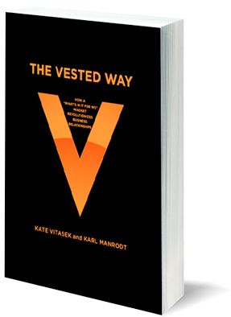
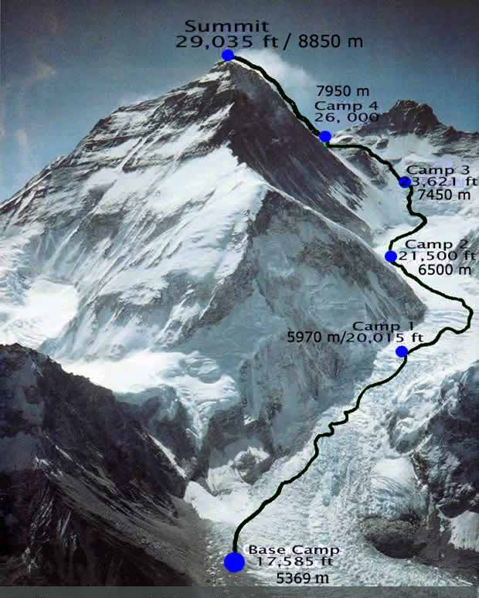
Photo by Alison Levine

Slide 3
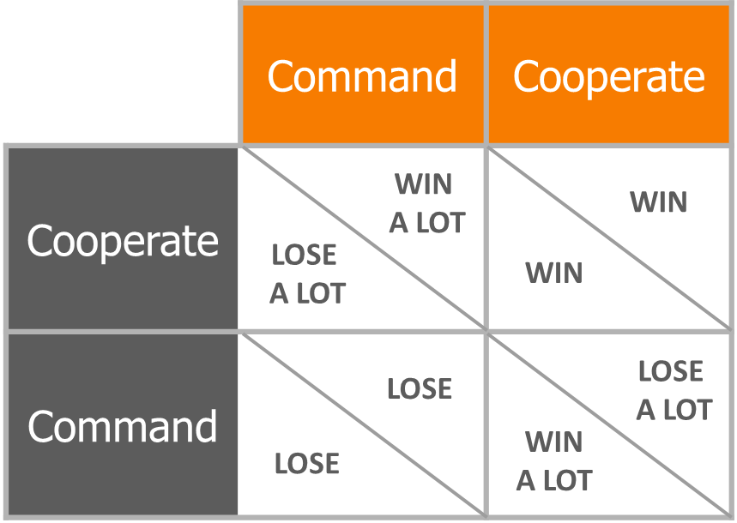
Win-Win Is Steeped in Research
John Nash was awarded the Nobel Prize in 1994
Source: http://en.wikipedia.org/wiki/A_Beautiful_Mind_(film)

Slide 4
Style Matters: Not Playing Nicely Can Cost You!
“Muscular buyers not only use their suppliers, but they often ‘use up’ their suppliers and discard them.
The muscular approach to outsourcing of goods and services is myopic and inefficient.”
https://www.econ.berkeley.edu/profile/`oliver-williamson
Oliver Williamson
University of California, Berkeley
Williamson was awarded the Nobel Prize in 2009

Slide 5
Solow’s Law
Business Growth is Driven by Innovation
87% of economic growth is driven by “technical change” that comes from improvements in business process or technical improvements in products
Labor & Physical Capital 13% (e.g. buildings, machinery)
The vast majority of today’s commercial contracts are for labor and physical capital rather than for innovation and problem solving!
Solow’s Findings

Slide 6
Vested Is a Hybrid Business Model
Shifts from a conventional “buy/sell” business model focusing on transactions to an “outcome” based business model focusing on results
Moves beyond saying “strategic supplier” to developing carefully crafted collaborative agreements
Creates value through win-win solutions economics (grow the pie, not fight over the pie)
HIGH
INVESTMENT
EQUITY PARTNER
SHARED SERVICES
RELATIONAL
VESTED
RELATIONSHIPS
DPEENDECY / RISK
PERFORMANCE-BASED RELATIONSHIP
TRANSACTIONAL
PREFERRED PROVIDER
APPROVED PROVIDER
SIMPLE TRANSACTION PROVIDER
LOW
Source: ©2015 Vested®
LOW
POTENTIAL TO CREATE VALUE
HIGH

Slide 7
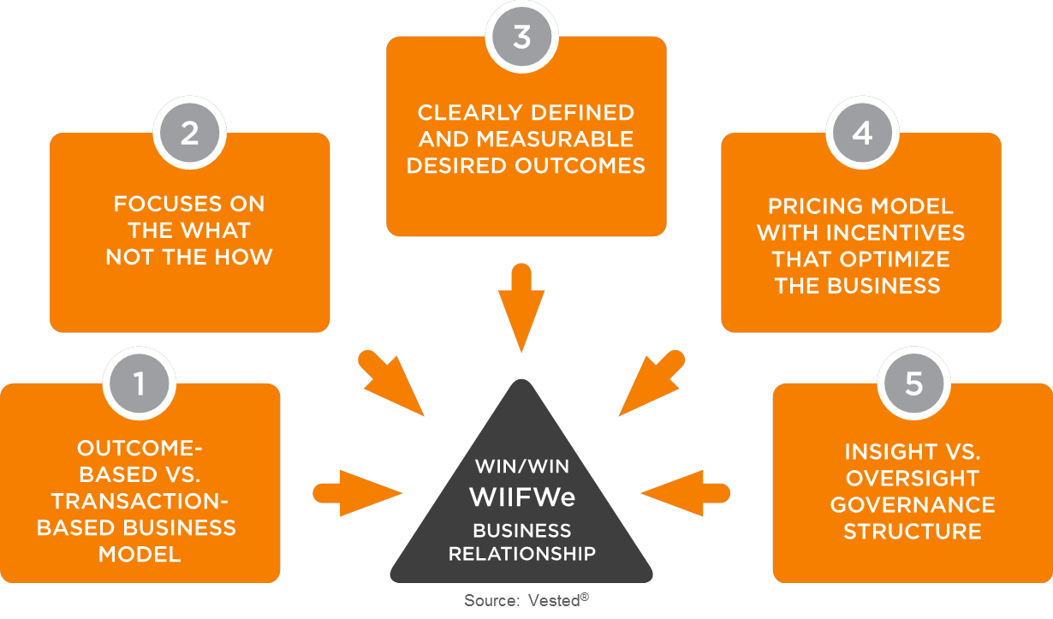
And It Applies FIVE Core Concepts

Slide 8
1. Outcome Based vs. Transaction Based Model
Most relationships follow a transaction-based business model
This can be cost plus or a fixed price per transaction where the service provider gets paid a transaction fee for each activity that is performed
Vested moves to an outcome-based business model where the service provider is paid for achieving results, not just for performing tasks or activities
Transaction-Based Thinking Results in “The Activity Trap”

Slide 9
2. Focus on the WHAT, Not the HOW
Joy’s Law:
No matter who you are, most of the bright people don’t work for you

Slide 10
3. Clearly Defined/Measurable Desired Outcomes
“You got to be very careful if you don't know where you're going, because you might not get there”
- Yogi Berra

Slide 11
4. Pricing Model with Incentives That Optimize the Business
Solow’s Law: Business Growth is Driven by Innovation
87% of economic growth is driven by “technical change” that comes from improvements in business process or technical improvements in products
Labor & Physical Capital 13% (e.g. buildings, machinery)
The vast majority of today’s commercial contracts are for labor and physical capital rather than for innovation and problem solving!
Solow’s Findings

Slide 12
5. Insight vs. Oversight Governance Structure
ME
WE
Getting the service provider to meet my needs
It’s in the contract, now it’s the service provider’s problem
Blame and punish the service provider
Unpleasant surprises
Finding a way to meet our mutual needs
Work together to achieve performance and compensation goals
Communicate the issues, jointly find solutions
Integrated planning and communications
BECOMES
Manage the Business… Not Just the Supplier
Notes:
Often have a small army of people referred to as “program managers” to micromanage the provider
An effective VO outsources to service providers that are real experts in those processes
Definitions:
Insight: Power of acute observation and deduction; penetration, discernment, perception
Oversight: Watchful care; superintendence; general supervision
A properly structured governance structure should establish good insight – not provide layers of supervisory oversight
If you make a mistake that costs your partner money, perhaps you should pay for it…..

Slide 13
Benefits: The Vested Approach Works!
Focus on intended results, not activities
Parties are Vested in each other’s success; risk and reward are shared to align interests
Mutually beneficial, shared incentives drive innovation and cost effectiveness
Better competition: not just activities/suppliers, but solutions
Mutually agreed Desired Outcomes creates buy-in and focus
Shared focus increases likelihood of meeting corporate goals and objectives
TCO and ROI emphasis enables sustainable results beyond simple “price” reductions
Overall better value and enhanced performance!

Slide 14
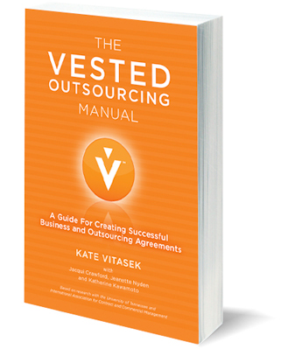
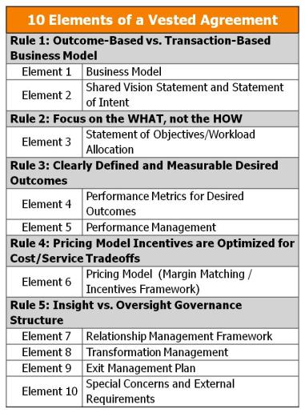
Getting Your Agreement to Vested

Slide 15
Vested Methodology Prevents Agreement Failures
Percent of Respondents
Note: 11% in “Other”
Source: Outsourcing Center Survey. Outsourcing Center
Notes:
11% in the other category

Slide 16
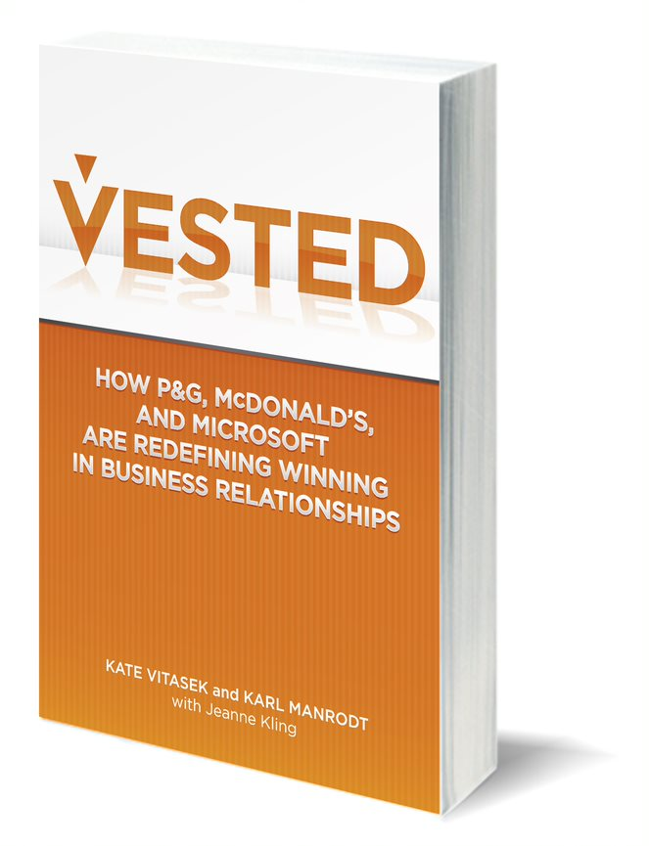
Who: Read About Success Stories
P&G (Real Estate/Facilities Management)
Microsoft (BPO)
McDonald’s (Supply Chain)
U.S. Dept. of Energy (Environmental Services)
State of Minnesota Dept. of Transportation (Construction)
Integrated Management Services (Staffing)
Diversey (IT)
Water for People (non-profit NGO support in developing countries)
Vancouver Coastal Health/BISS (Environmental Services)
TD Bank (Real Estate/Facilities Management)

Slide 17
What They Are Saying…
Tim Cummins, CEO, International Association for Contract & Commercial Management
"Vested offers a robust approach for developing high-performing strategic relationships”
Dawn Tiura Evans – President and CEO, Sourcing Interests Group “Kate has hit the nail on the head. The “rules” while often spoken about have never been so clearly defined as they are here. The journey to a truly collaborative Agreement is practically guaranteed if you follow the step-by-step process outlined in this great book.”
Peter Sheahan, Founder and CEO, ChangeLabs and Author of the Best Selling Book “Flip”
“Vested truly flips conventional outsourcing on its head. Kate has captured what it takes to drive REAL value through your external partnerships. A must read for anyone who wants to do outsourcing.”
Frank Casale – CEO, Outsourcing Institute
“Vested is a game-changing approach that will quickly become the new gold standard for advanced outsourcing relationships. It is a critical enabler for Outsourcing 2.0.”
Tim McBride – Chief Procurement Officer, Microsoft
“As the Chief Procurement Officer at Microsoft it is my job to help us adopt next generation outsourcing models and Vested is definitely one of the tools we have in our toolkit that we are exploring”
Todd Shire, Global Logistics Sourcing Strategy Manager, Intel
"I predict the buzzword for the next decade will be "incentives." Only when our incentives are aligned will we succeed with collaboration. Vested nails how to get collaboration right.“
Wall Street Journal – Six Ways Small Businesses Can Save Money Vested is identified as one of “six ways small businesses can save money”

Slide 18
How to Start Your Journey

Slide 19
Contact Us
Visit the University of Tennessee’s dedicated Vested website at www.vestedway.com
Contact Kate Vitasek – the lead researcher and faculty for Vested at kvitasek@utk.edu
Contact a Center for Excellence for implementation support
UT is World Class
for Supply Chain Management
#1 most relevant Executive Education Program - The Economist
#1 for research - Transportation Journal
#2 graduate program - Gartner
#3 undergraduate program - US News & World Report
#3 public Executive Education program
Financial Times
#4 empirical research SCM Journal

Slide 20
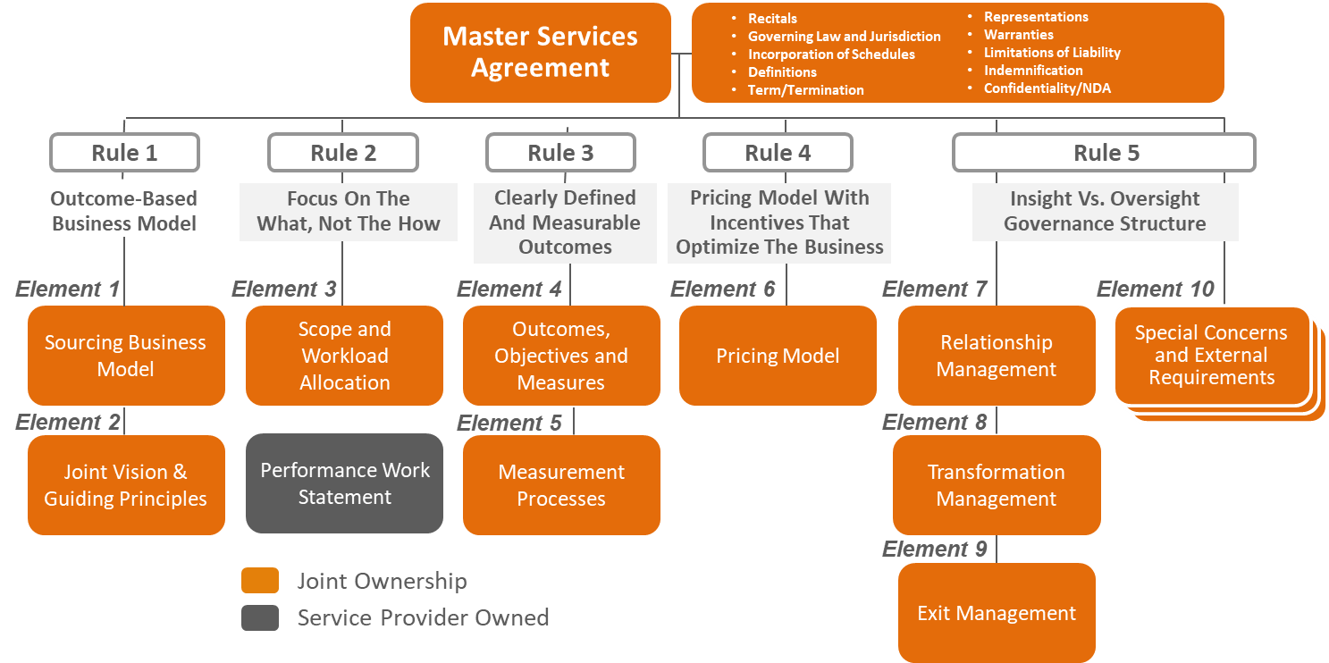
Creating a Vested Agreement Online Courseware
Cost: Individual Seat License for $3,500; Corporate/group licenses available
The Creating a Vested Agreement course is designed to help you and your partner (e.g., customer, supplier, non-profit alliance partner) jointly develop a Vested Agreement
The course consists of self-paced, video-based Topics that deliver critical knowledge and a step-by-step process for creating your own Vested Agreement
The course includes a comprehensive Vested Toolkit® that accompanies each module; when completed – you will create the physical deliverables and contractual schedules of your own Vested Agreement
Ideally, all partners involved will take this course as a joint “deal team” and complete the work jointly using the Vested Toolkit provided
Register here

