Slide 1
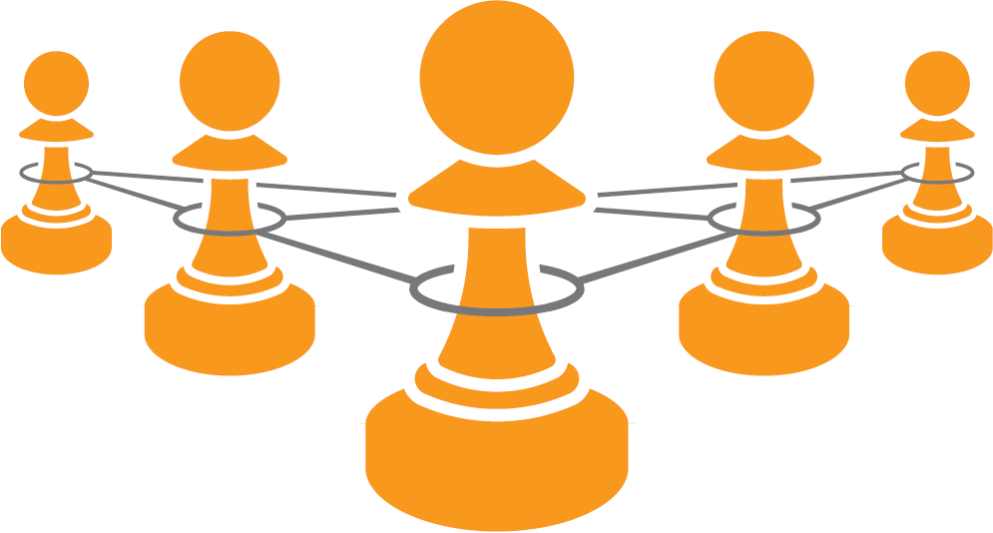
STRATEGIC
SOURCING IN THE
NEW ECONOMY
Harnessing Sourcing Business Models
For Modern Procurement

Slide 2
Strategic Sourcing in the New Economy
Based on a decade + of research by the University of Tennessee
Challenges procurement leaders to include more modern thinking into their procurement practices
Introduces Sourcing Business Models theory – and provides a step-by-step roadmap for putting the theory into practice
Source: STRATEGIC SOURCING IN THE NEW ECONOMY: HARNESSING THE POTENTIAL OF SOURCING BUSINESS MODELS FOR MODERN PROCUREMENT, Keith, Vitasek Manrodt & Kling, Palgrave 2015

Slide 3
The Conventional Approach: Make vs Buy
The conventional approach looks at sourcing from a “make” or “buy” decision. Most organizations use a transaction-based relationship and economic model when they “buy” goods or services.
Buy
Make
Create
“Corporate
Hierarchy”
Use
“The Market”

Slide 4
A New View: a “Hybrid” Approach
Dr. Oliver Williamson’s Nobel Prize work suggested organizations consider a “hybrid” approach using more flexible relational contracts for strategic supplier relationships.
There is a
whole playground
in the middle!
Buy
Make
Use
“The Market”
Create
“Corporate
Hierarchy”
“Hybrid” Approach
Source: STRATEGIC SOURCING IN THE NEW ECONOMY: HARNESSING THE POTENTIAL OF SOURCING BUSINESS MODELS FOR MODERN PROCUREMENT, Keith, Vitasek Manrodt & Kling, Palgrave 2015

Slide 5
Sourcing Business Model Theory
BUY
MAKE
“Market”
“Hybrid”
“Hierarchy”
SOURCING CONTINUUM
TRANSACTIONAL |  | RELATIONAL |  |  | INVESTMENT
Basic Provider Model | Approved Provider Model | Preferred Provider Model | Performance Based / Managed Services Model | Vested Business Model | Shared Services Model | Equity Partnerships
Source: STRATEGIC SOURCING IN THE NEW ECONOMY: HARNESSING THE POTENTIAL OF SOURCING BUSINESS MODELS FOR MODERN PROCUREMENT, Keith, Vitasek Manrodt & Kling, Palgrave 2015

Slide 6
What Is a Sourcing Business Model?
A Sourcing Business Model is a combination of an organizations Relationship Model and Economic Model
There are seven Sourcing Business Models, each serving to optimize for 25 key business attributes
An organization should consciously select the Sourcing Business Model that is most appropriate for their sourcing situation in order to optimize for their business environment
Source: STRATEGIC SOURCING IN THE NEW ECONOMY: HARNESSING THE POTENTIAL OF SOURCING BUSINESS MODELS FOR MODERN PROCUREMENT, Keith, Vitasek Manrodt & Kling, Palgrave 2015

Slide 7
Relationship Model and the Economic Model
 | Relationship Model | Economic Model
What is It? | A relationship model determines how you will formally control or influence your supply source | An economic model determines how you will manage the economics of the relationship
What are your decisions | Three relationship models: Transactional Contract (Market) Relational Contract (Hybrid) Investment / Vertical Integration (Hierarchy) | Three economic models: Transaction-Based Activities drive behavior, e.g. pay per Unit, per Hour, per Activity) Output-Based Pay for supplier output such as SLAs or Guaranteed savings glide-path Outcome-Based Boundary Spanning/Business Outcomes with shared risk/shared reward
Source: STRATEGIC SOURCING IN THE NEW ECONOMY: HARNESSING THE POTENTIAL OF SOURCING BUSINESS MODELS FOR MODERN PROCUREMENT, Keith, Vitasek Manrodt & Kling, Palgrave 2015

Slide 8
What Sourcing Business Model Is Best?
Determining which Sourcing Business Model is best for your situation is easy when you complete a Sourcing Business Model Mapping exercise!
A Sourcing Business Model Mapping exercise where you assess your category against 25 key attributes will help you answer two key questions
What relationship model should you use?
What economic model should you use?
Based on your answers, you will then “map” your answers to the Business Model Map Matrix
The Sourcing Business Model you pick greatly depends on your level of dependency/risk and your potential to create value
Source: STRATEGIC SOURCING IN THE NEW ECONOMY: HARNESSING THE POTENTIAL OF SOURCING BUSINESS MODELS FOR MODERN PROCUREMENT, Keith, Vitasek Manrodt & Kling, Palgrave 2015
8

Slide 9
Business Model Mapping Matrix
The Business Model Mapping matrix allows you to “map” your business environment against the complete list of attributes.
 |  | Relationship/Contract Model
 |  | Transactional Contract (Market) | Relational Contract (Hybrid) | Investment (Vertical Integration / Hierarchy)
Economic Model | Outcome-Based Economics tied to Boundary Spanning/Business Outcomes | Mismatch – Not a Viable Strategy | Vested | Equity Partner (e.g. Joint Venture) or Shared Services
 | Output-Based (Performance-Based / Managed Services) Economics tied to Supplier Output | Mismatch – Not a Viable Strategy | Performance-Based (Managed Services) Agreement
 | Transaction-Based Economics tied to activities drive behavior | Basic Provider Approved Provider | Preferred Provider
Source: STRATEGIC SOURCING IN THE NEW ECONOMY: HARNESSING THE POTENTIAL OF SOURCING BUSINESS MODELS FOR MODERN PROCUREMENT, Keith, Vitasek Manrodt & Kling, Palgrave 2015
Notes:
The answer to how you mapped each attribute will determine the relationship model and the economic model. Combined, these two factors will determine which of the seven sourcing business models is best for your sourcing situation.
Most organizations understand the need to have more strategic supplier relationships. However, they are structuring contracts that do not have the right level of relationship or economics. This is creating inherent perverse incentives and tensions with suppliers.
As dependency on the supplier increases you move up on the relationship scale from transactional to relational models. As the desire for value creation increases you up the scale of economic models from transaction based, to output based and finally to outcome based economic models.
The matrix shown places each sourcing model on the matrix based on its economic and relationship model.
Additional background information on Sourcing Business models can be found in COURSE 1 - Sourcing and Business: Essential Background Knowledge, Module 9 Introduction to Sourcing Business Models

Slide 10
Level of Dependency
 |  | Relationship/Contract Model
 |  | Transactional Contract (Market) | Relational Contract (Hybrid) | Investment (Vertical Integration / Hierarchy)
Economic Model | Outcome-Based Economics tied to Boundary Spanning/Business Outcomes | Mismatch – Not a Viable Strategy | Vested | Equitable Partner Vested Shared Services
 | Output-Based (Performance-Based / Managed Services) Economics tied to Supplier Output | Mismatch – Not a Viable Strategy | Performance-Based (Managed Services) Agreement | Equitable Partner Shared Services
 | Transaction-Based Economics tied to activities drive behavior | Basic Provider Approved Provider | Preferred Provider | Equity Partner Shared Services
Dependency increases
As you move across the continuum
Most organizations understand the need to have more strategic supplier relationships. As you work with suppliers in a more strategic manner your dependency increases.
Source: STRATEGIC SOURCING IN THE NEW ECONOMY: HARNESSING THE POTENTIAL OF SOURCING BUSINESS MODELS FOR MODERN PROCUREMENT, Keith, Vitasek Manrodt & Kling, Palgrave 2015

Slide 11
The Value Connection
 |  | Relationship/Contract Model
 |  | Transactional Contract (Market) | Relational Contract (Hybrid) | Investment (Vertical Integration / Hierarchy)
Economic Model | Outcome-Based Economics tied to Boundary Spanning/Business Outcomes | Mismatch – Not a Viable Strategy | Vested | Equitable Partner Vested Shared Services
 | Output-Based (Performance-Based / Managed Services) Economics tied to Supplier Output | Mismatch – Not a Viable Strategy | Performance-Based (Managed Services) Agreement | Equitable Partner Shared Services
 | Transaction-Based Economics tied to activities drive behavior | Basic Provider Approved Provider | Preferred Provider | Equity Partner Shared Services
Value increases as you move up the continuum
When appropriately applied, an organization can derive more value by thinking in terms of “outputs” or “outcomes” versus simple “transactions”.
Source: STRATEGIC SOURCING IN THE NEW ECONOMY: HARNESSING THE POTENTIAL OF SOURCING BUSINESS MODELS FOR MODERN PROCUREMENT, Keith, Vitasek Manrodt & Kling, Palgrave 2015

Slide 12
Use the Toolkit to Get Started!
The Sourcing Business Model Toolkit is an open source toolkit designed to help you identify the most appropriate Sourcing Business Model for each of your spend categories.
Visit www.vestedway.com to download the latest Business Model Mapping toolkit.

Slide 13
Business Model Mapping
The Business Model Mapping exercise includes four steps that – when properly completed – will help you determine what is the most appropriate Sourcing Business Model for your specific situation.
Step 1: Select the defined spend category/categories you are sourcing/potentially sourcing.
Step 2: Use the Business Model Mapping Template to determine the best relationship model for what you are sourcing (map the first 14 attributes on the first page of the template)
Step 3: Use the Business Model Mapping Template to determine the best economic model for what you are sourcing (map the 11 attributes on the second page of the template)
Step 4: Use the Sourcing Business Model Matrix to develop a consensus view of which Sourcing Business Model is right for you. The best Sourcing Business Model will be a combination of which relationship model and which economic model you choose.
Source: STRATEGIC SOURCING IN THE NEW ECONOMY: HARNESSING THE POTENTIAL OF SOURCING BUSINESS MODELS FOR MODERN PROCUREMENT, Keith, Vitasek Manrodt & Kling, Palgrave 2015

Slide 14
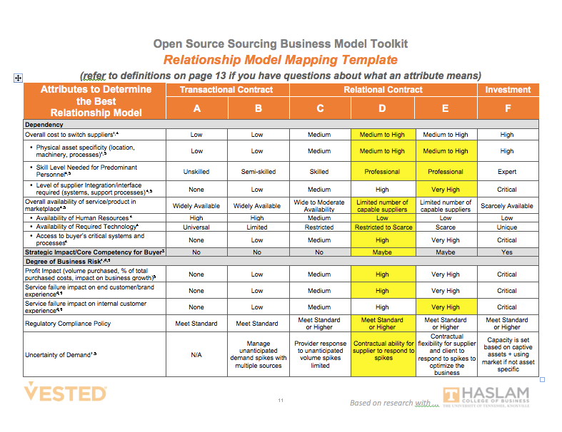
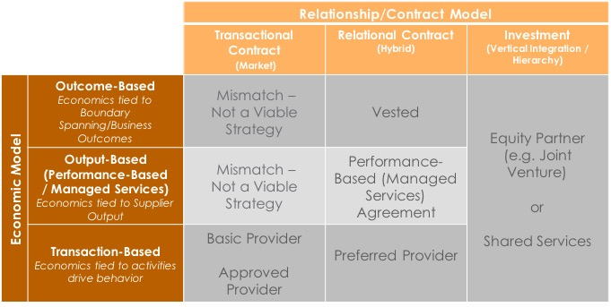
Example
Step 1
Relationship Model is “Relational”
Step 2
Define the scope of the services you want to map.
1. Janitorial
2. Dining
3. Facilities maintenance
4. Real estate transactions
Economic Model is “Output”
Step 3
Relationship Model Template
Step 4
Sourcing Business Model Mapping Matrix
Economic Model Template
Source: STRATEGIC SOURCING IN THE NEW ECONOMY: HARNESSING THE POTENTIAL OF SOURCING BUSINESS MODELS FOR MODERN PROCUREMENT, Keith, Vitasek Manrodt & Kling, Palgrave 2015

Slide 15
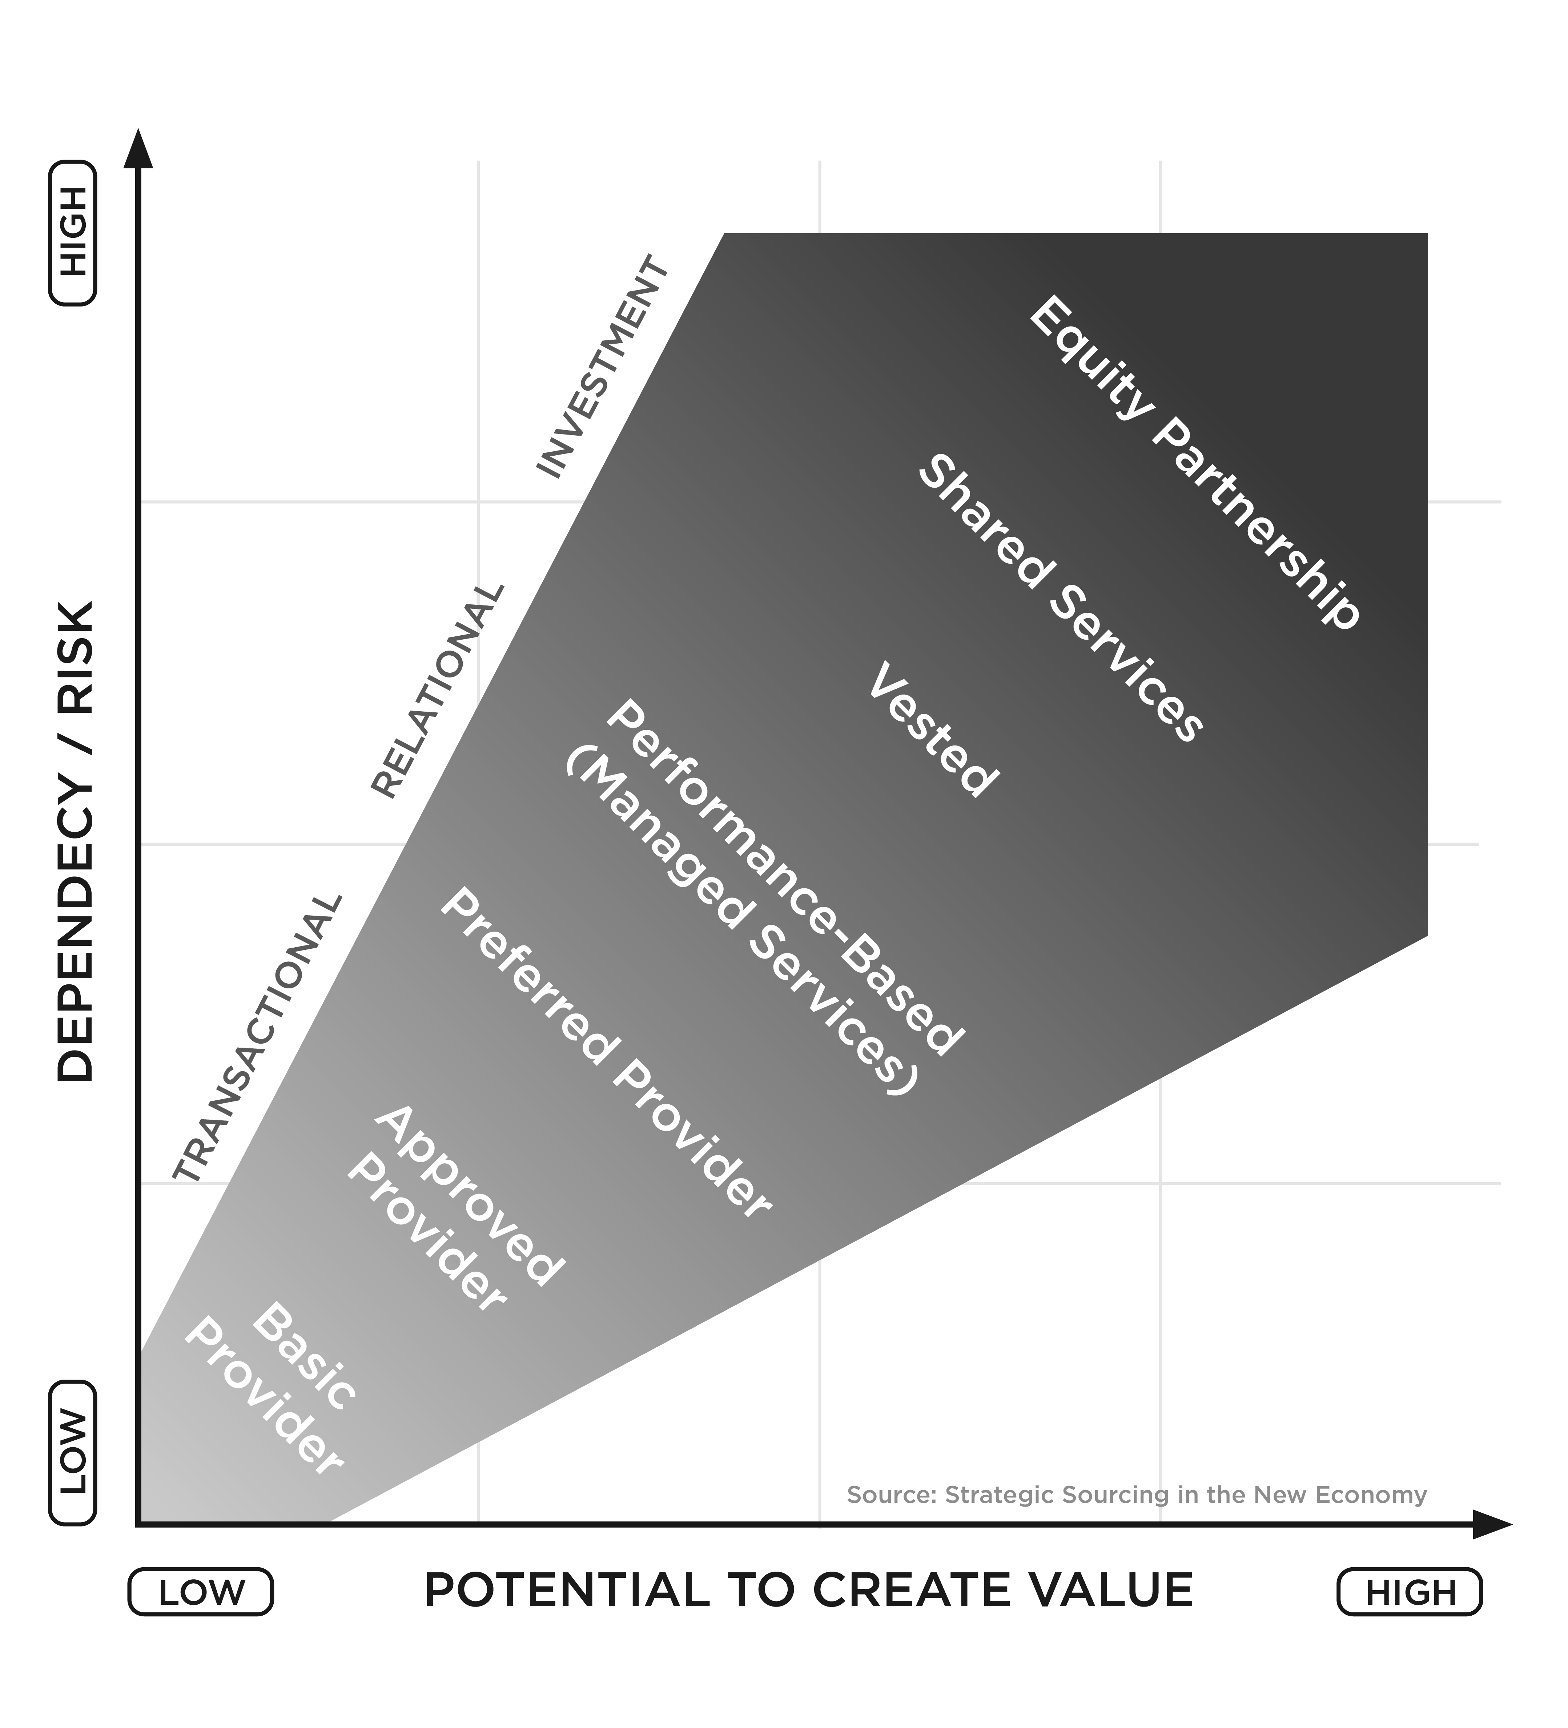
Simplified Sourcing Business Model Framework
You can also plot your results on the Sourcing Model framework.
While your “map” of the 25 attributes determines which Sourcing Business Model is best, you can summarize your level of dependency/risk and your potential to create value using this simple 2x2 framework.
Source: STRATEGIC SOURCING IN THE NEW ECONOMY: HARNESSING THE POTENTIAL OF SOURCING BUSINESS MODELS FOR MODERN PROCUREMENT, Keith, Vitasek Manrodt & Kling, Palgrave 2015

Slide 16
Learn More….
The book Strategic Sourcing in the New Economy goes into great detail about Sourcing Business Models.
If you have questions about our open source or licensed training materials – please contact kvitasek@utk.edu

