Slide 1
UT Courses & CDA Program Overview

Slide 2


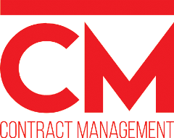
Welcome to the
University of Tennessee’s
Haslam College of Business for Graduate and Executive Education

Slide 3


Join us…
Join us at the University of Tennessee’s College of Business Administration for one – or all – of our ten courses dedicated to helping professionals learn the art, science and practice of developing highly collaborative agreements designed to create value and drive innovation for your organization!
Whether you are just starting to learn about the Vested business model, are seeking step-by-step support to craft an actual Vested agreement with a business partner, or are seeking recognition as a Certified Deal Architect (CDA), we have a course just right for you
Courses can be taken individually – or take as a complete package if you are seeking Certification as a Deal Architect. The CDA program is ideal for individuals responsible for more than one deal, or consultants and lawyers who assist companies with their deals

Slide 4


Ten Courses in the Certified Deal Architect Program
Awareness
Understanding
Implementation
Mastery
FREE
Creating a
Agreement
Five Rules That Will Transform
Business Relationships
CDA Coach
3-Day Executive
Education
Course
Orientation
Validation
Continuing Education
On Campus/
On Site/Virtual
Online Course
Online Course
Online Course*
Distance Learning
Distance Learning
FREE
FREE
`
Is
Right for Your Situation?
Not Ready for Vested?
Register for…
Collaborative Contracting:
2-Day Executive
Education Course
Getting Ready for Your
Journey
On Campus/
On Site/Virtual
Online Course
Online Course
Online Course
* Prerequisites for Creating a Vested Agreement class are:
Five Rules, Is Vested Right?, Getting Ready, and
the Vested 3-Day Executive Education Course
OR
Be working with a Vested Center of Excellence

Slide 5

How the Program Works
The Certified Deal Architect program is very similar to a Six Sigma Black Belt and other certification programs, consisting of five levels of certification.
Understanding
Implementation
Mastery
Foundation
Certificate
Practitioner
Certificate
CERTIFIED DEAL
ARCHITECT
CDA COACH
FACULTY
Six Sigma | White Belt/ Yellow Belt |  | Green Belt | Black Belt |  | Master Black Belt | Sensei
Agile | Agile Scrum Foundation |  | Practitioner | Scrum Master |  | Agile Coach | Professional Scrum Master/ Scrum Trainer
ITIL | ITIL Foundation |  | Practitioner | Intermediate |  | Expert | Master

Slide 6
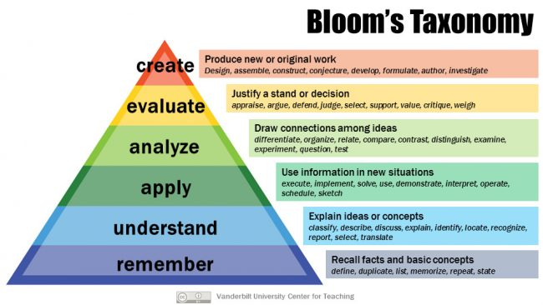
How Certification Maps to Blooms Learning Taxonomy
Bloom’s Taxonomy is a worldwide recognized approach for classifying learning objectives.
Vested Faculty
Certified Vested Coach
Certified Deal Architect
Practitioner Certificate
Foundation Certificate

Slide 7
Eligibility
Anyone is eligible for the program (e.g., individuals working in the buy or sell-side, consultants, and lawyers)
To graduate as a Certified Deal Architect, you must complete all of the coursework and complete a project for validation with a faculty member
If you have successfully applied the Vested concepts you will be awarded with a Certified Deal Architect status
To graduate as a Certified Deal Architect Coach you must complete a skills validation assessment hosted by one of the regional Vested Centers of Excellence
Courses can be taken:
  Individually based on where a person is at in their own Vested journey (awareness, understanding, implementation, mastery)
  As a complete program ($1000 discount)

Slide 8
The Foundation Certification
Understanding
Implementation
Mastery
Foundation
Certificate
Practitioner
Certificate
CERTIFIED DEAL
ARCHITECT
CDA COACH
FACULTY

Slide 9
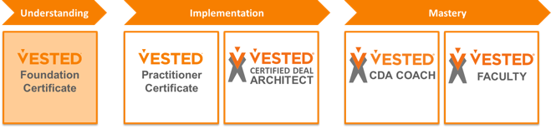

Foundation Certificate
To earn a Foundation Certificate, individuals must complete two online courses
Awareness
Understanding
Implementation
Mastery
FREE
Creating a
Agreement
Five Rules That Will Transform
Business Relationships
CDA Coach
3-Day Executive
Education
Course
Orientation
Validation
Continuing Education
On Campus/
On Site/Virtual
Online Course
Online Course
Online Course*
Distance Learning
Distance Learning
FREE
FREE
Is
Right for Your Situation?
Collaborative Contracting:
2-Day Executive
Education Course
Getting Ready for Your
Journey
On Campus/
On Site/Virtual
Online Course
Online Course
Online Course

Slide 10
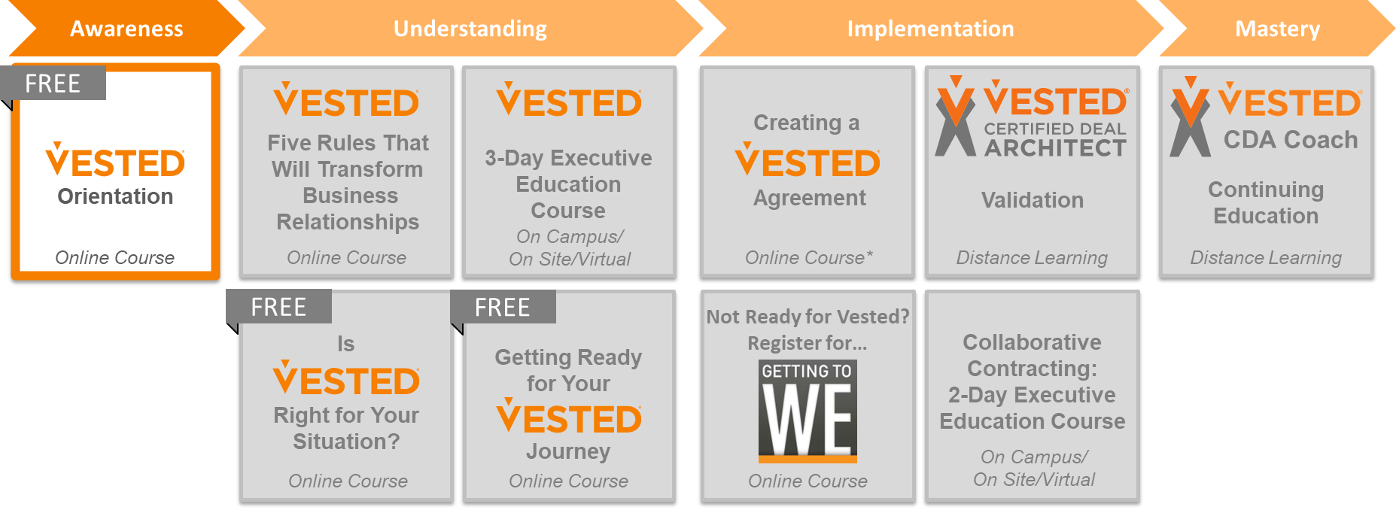
Vested Orientation (online)
Awareness
Learn more about how to achieve your goals through a highly collaborative Vested business model with our free Vested Orientation online course
Vested Orientation is a free online course comprised of thirteen self-paced video Topics of 20 minutes or less designed to help anyone, anywhere in the world build a basic understanding and awareness of Vested
This course is designed to provide an overall awareness of Vested and will help you learn the essential principles of why a Vested approach is needed for strategic relationships.
The following page provides a course outline and learning objectives

Slide 11
What You Will Learn…
FREE
Understand why and how Vested is different than conventional approaches for procuring goods and services
Recognize the “ailments” in your existing relationships – including being able to complete your own self-diagnostic
Learn the essential foundational elements of developing any relationship – Vested or not
Understand whether a Vested approach is right for you
Learn from the Vested journeys of several notable companies
Vested Orientation
1 | Introduction
2 | About the Research/Key Findings
3 | Overview of the Vested Methodology
4 | Mindset, Business Model, Movement
5 | Outsourcing Paradox
6 | 12 Ailments of Conventional Outsourcing
7 | New Economics of Commerce
8 | Lessons for Commercial Relationships
9 | Laying the Foundation for a WIIFWe Mindset
10 | WIIFWe Case Studies
11 | Getting Started on Your Journey
12 | Resources to Assist You
13 | What’s Next?
Cost: Free
Register here

Slide 12
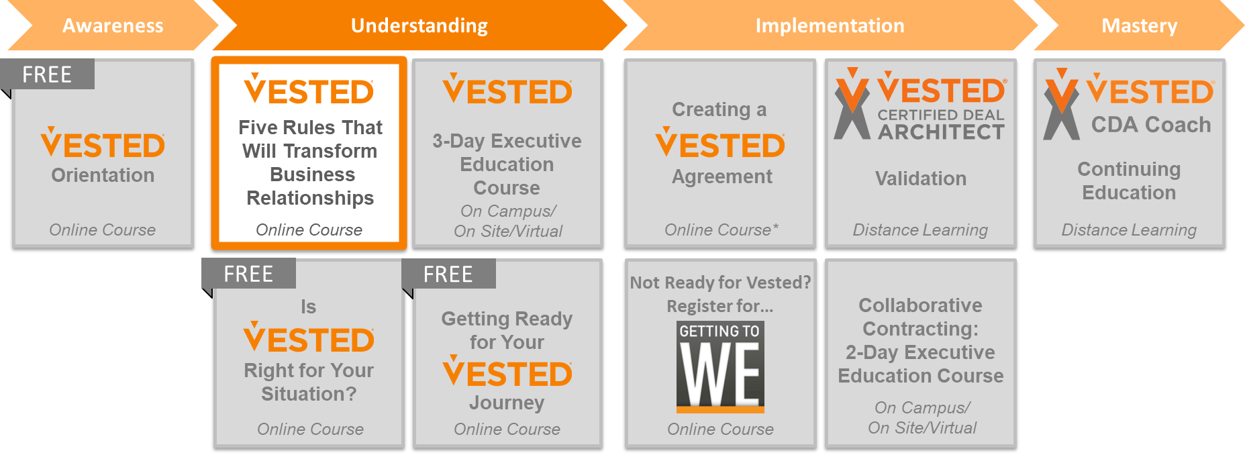
Vested Five Rules (online)
Understanding
This course uses self-paced, video-based Topics allowing you to learn and do at your own pace
  Seven Course Modules, with one Module dedicated to each of the Five Rules
Each Module includes several short (20 minutes or less) “Topics” , which will help you learn how to apply the Vested “Five Rules” that are essential for creating a highly collaborative Vested business model
The course provides a perfect blend of theory and practice – sharing real examples of how companies are applying each of the Five Rules
The course also includes two self assessments – included to help you analyze how you have structured an existing relationship
The following page provides a course outline and learning objectives

Slide 13
What You Will Learn…
Five Rules
Introduction | An Introduction to Five Rules
Rule 1 | Outcome-Based vs. Transaction-Based Business Model
Rule 2 | Focus on the What, Not the How
Rule 3 | Clearly Defined and Measurable Desired Outcomes
Rule 4 | Pricing Model with Incentives to Optimize the Business
Rule 5 | Insight vs. Oversight Governance Structure
Conclusion | Applications and Next Steps
Understand each of Vested’s Five Rules, including why they are so crucial
Learn from real world examples of how companies have applied each of Vested’s Five Rules
  Perform a self-diagnostic using the Vested 10 Elements self-assessment to see how one of your deals stacks up
Understand the foundational elements needed begin your Vested journey
Complete a “Readiness Assessment”
Explore the options for Creating a Vested Agreement
Cost: $475 as a standalone class
Free if registering for any of our other courses
Register here

Slide 14
The Practitioner Certificate
Understanding
Implementation
Mastery
Foundation
Certificate
Practitioner
Certificate
CERTIFIED DEAL
ARCHITECT
CDA COACH
FACULTY

Slide 15
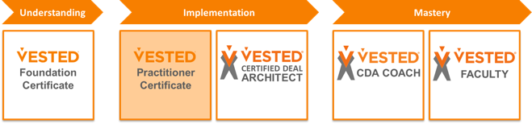
Practitioner Certificate
Individuals must complete five courses to earn a Certified Vested Practitioner Certificate*
Awareness
Understanding
Implementation
Mastery
FREE
Creating a
Agreement
Five Rules That Will Transform
Business Relationships
CDA Coach
3-Day Executive
Education
Course
Orientation
Validation
Continuing Education
On Campus/
On Site/Virtual
Online Course
Online Course
Online Course*
Distance Learning
Distance Learning
FREE
FREE
Collaborative Contracting:
2-Day Executive
Education Course
Is
Right for Your Situation?
Getting Ready for Your
Journey
On Campus/
On Site/Virtual
Online Course
Online Course
Online Course
* Individuals pursuing their Practitioner Certificate do not have to complete the Foundation Certificate first. This allows people to skip the Vested Orientation basic course.

Slide 16
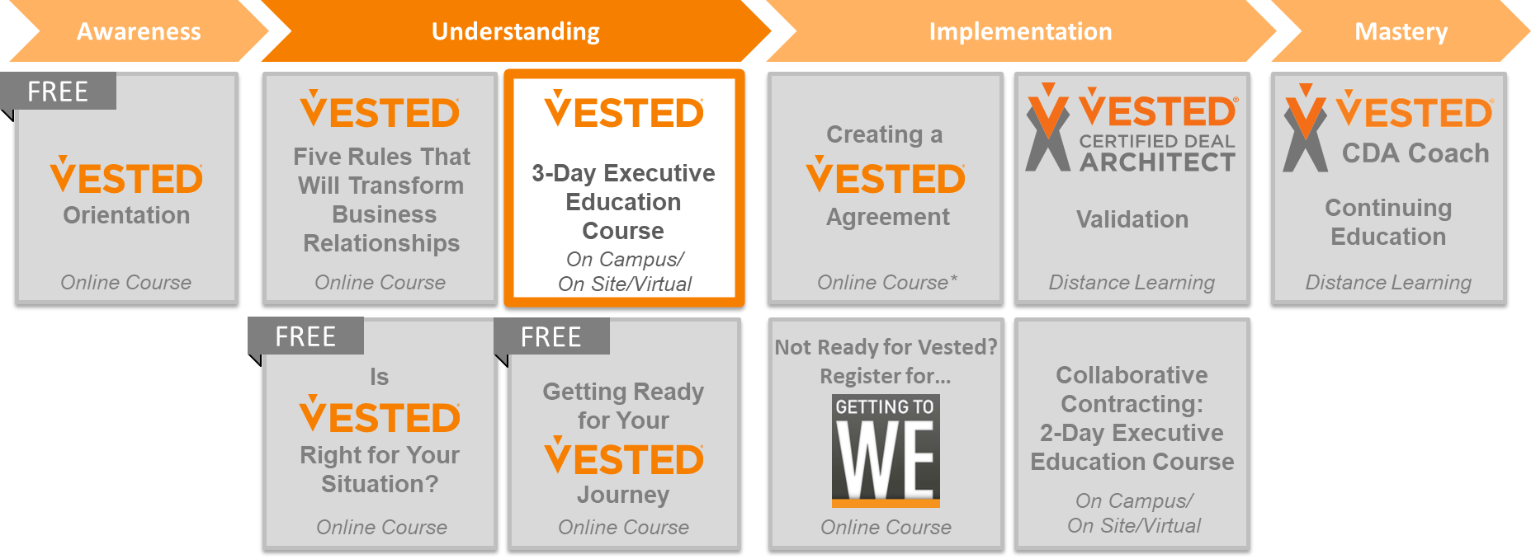
3-Day Executive Education Course
Understanding
Onsite: Hosted in Knoxville, Stockholm and Amsterdam or available as a private course
Virtual: The virtual option than spans five 4-hour virtual sessions
The 3-Day Executive Education course is ideal for companies who are uncertain whether Vested is right for them, or who are unsure how to start
The course is designed to provide a comprehensive overview of the Vested business model; attendees see first hand how to develop their own highly collaborative Vested business model with their strategic partners
The small class size provides a rich experience where participants can interact with the UT Faculty who created the Vested business model In addition, the interactive Real Play® sessions allow you to identify gaps in your existing agreement and help you create an action plan for what needs to be done to shift your relationship to a Vested business model that will enable you – and your partner – to unlock hidden potential by creating a true win-win Vested approach.
The following page provides a course outline and learning objectives
This class is co-sponsored with Council of Supply Chain Management Professionals
UT is an IAOP Academic Alliance Partner, and this class has been accepted for the Certified Outsourcing Professional Bridge Program and qualifies for COP credit.
UT is also an NCMA Education Partner. Counts towards APICS recertification

Slide 17

What You Will Learn…
Go behind the scenes with real case studies that profile how leading companies have applied a Vested business model to create true win-win business relationships yielding transformation results
Answer the question – Is Vested right for us? by understanding the fundamental business model differences between traditional outsourcing approaches, performance-based approaches and the Vested business model – and when to apply them
Answer the question – Is our supplier is the right fit? including identifying structural flaws and creating a roadmap for what needs to be done to shift your relationship to a Vested business model
Answer the question – Are we ready for Vested? by working through the 5 key components of readiness and identifying your gaps
Answer the question – What resources do we need? by getting hands-on experience and use of the Vested Toolkit®, including practicing how to link Desired Outcomes to a Requirements Roadmap – a key to developing a sound Vested Agreement
Leave the course with a customized roadmap and action plan for how you can begin to adopt a Vested business model in your organization
Even if you even if you don't intend to create a Vested agreement – you will walk away from this course with a practical, applied roadmap that will improve any relationship – not matter how big or small
Cost: $3,500*; $1,750 If Repeating
This course can also be offered as a private course and delivered on site or in a virtual classroom for your organization
Register here
*Knoxville, Tennessee option Includes Meals And Lodging
Group Pricing = $3,150 for a group of 3-4 / $2,975 for a group of 5 or more

Slide 18
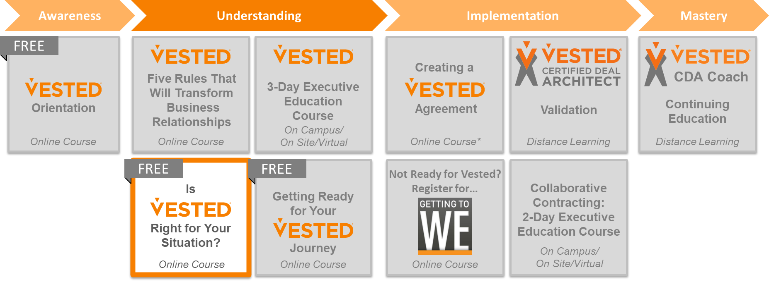
Is Vested Right For Your Situation? (online)
Understanding
Like the idea of Vested but not sure it is the appropriate business model for your situation?
This seven-topic FREE online course will help you answer the question “Is Vested right for your situation?”
Start by understanding the basics of what a sourcing business model is and end the course by completing a Business Model Map for your potential partnership where you will determine if Vested is the best path for you
The following page provides a course outline and learning objectives

Slide 19
What You Will Learn…
FREE
The Is Vested Right for Your Situation? online course consists of seven self-paced video topics – each 20 minutes or less. Upon completion you will be able to:
Understand the differences between Vested and the other six Sourcing Business Models
Access resources to help you share the fundamentals of Sourcing Business Models with Key Stakeholders within your company
Create a Sourcing Business Model Map for your spend category/deal/relationship
Answer the question “Is Vested the most appropriate business model for my situation?”
Is Vested Right for You?
Introduction | Introduction – Leveraging this class
Topic 1 | Why Change to Sourcing Business Models?
Topic 2 | Sourcing Business Model Theory
Topic 3 | Analyzing Sourcing Business Models
Topic 4 | Using the Business Model Mapping Tool
Topic 5 | Case Study – Shifting Up the Sourcing Continuum
Topic 6 | Finding Additional Resources
Topic 7 | What is Next on Your Journey?
Cost: Free
Register here

Slide 20
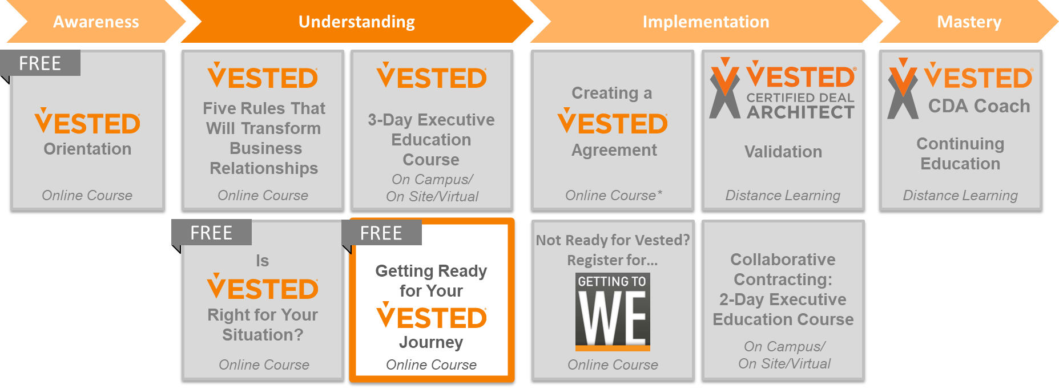
Getting Ready For Your Vested Journey (online)
Understanding
You’ve learned enough about what Vested is
You’ve completed a Sourcing Business Model Map and know it is a great option for your potential partnership
So what is next?
The Getting Ready online course is place to start your Vested journey
  You will start the course with a quick readiness assessment
  The course comes with 10 proven tools to help you close gaps in your readiness – including templates and resources to help you develop a project plan for your Vested initiative and determine who is best suited to be on your Deal Architect Team
The following page provides a course outline and learning objectives

Slide 21
What You Will Learn…
FREE
Getting Ready For Your Vested Journey
Intro | Getting the Most From This Course
Topic 1 | Readiness Factors and Pitfalls
Topic 2 | Completing a Readiness Assessment
Topic 3 | Closing Gaps – Stakeholder Analysis
Topic 4 | Closing Gaps – Vested Knowledge Base
Topic 5 | Closing Gaps – Champions
Topic 6 | Closing Gaps – Organizational Alignment
Topic 7 | Closing Gaps – Guardrails
Topic 8 | Building Your Team
Topic 9 | Establishing a Steering Committee
Topic 10 | Tips for Success – Structured Process
Topic 11 | Planning Your Initiative
The Getting Ready online course consists of twelve self-paced video topics – each 20 minutes or less
In this online course you will understand the five key ”Readiness” factors that lay the foundation for a successful Vested journey, and complete a Readiness Self-Assessment to gauge your Readiness to kick off your Vested journey
You will learn how to use resources and tools to help you close any gaps you have in Readiness before you start your Vested journey
You will also learn from common pitfalls others have experienced so you can avoid similar mistakes
Cost: Free
Register here

Slide 22
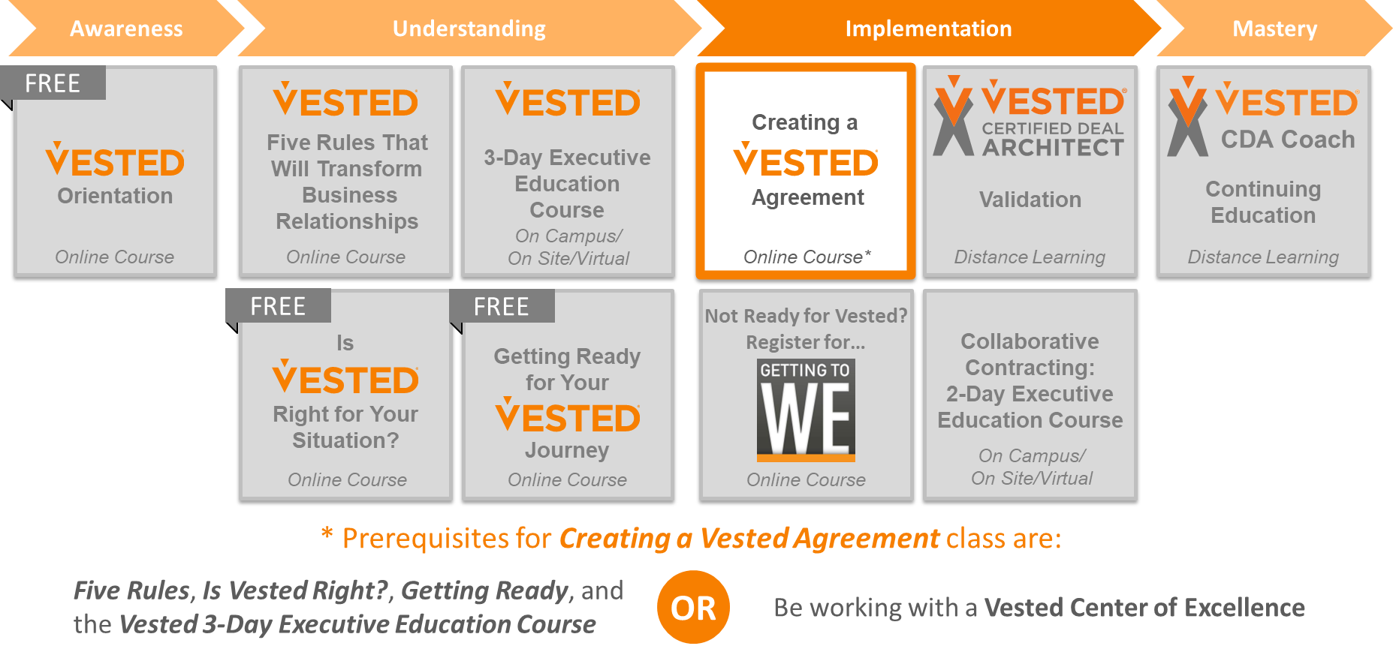
Creating A Vested Agreement (online)
Implementation
Not everyone can come to the University of Tennessee. And organizations typically develop agreements with their business partner at a pace that is unique for them.
For this reason we’ve created a unique Creating a Vested Agreement online course and comprehensive Vested Toolkit® you can use to help you to physically create an actual Vested agreement – regardless of your location
Whether you are developing a contract for a new relationship, or restructuring an existing agreement, this course is a must-have resource that is your roadmap to creating your own Vested Agreement
The following page provides a course outline and learning objectives
We have had individuals and organizations that want to use the course for educational purposes only and do not intend to create a Vested Agreement. The course can be repeated at no additional cost for up to one year when the individual/organization is ready to complete an actual Vested Agreement.

Slide 23
What You Will Learn…
The Creating a Vested Agreement course is designed to help you and your partner (e.g., customer, supplier, non-profit alliance partner) jointly develop a Vested Agreement
  The course consists of Seven Course Modules, with one Module dedicated to each of the Five Rules
  Each Module includes several short (20 minutes or less) “Topics” where you will learn how to put the Vested theory into practice
The course includes a comprehensive Vested Toolkit® that accompanies each module; when completed – you will create the physical deliverables and contractual schedules of your own Vested Agreement
Ideally, all partners involved will take this course as a joint “deal architect team” and complete the work jointly using the Vested Toolkit provided
1
2
3
4
5
LAYING THE FOUNDATION
OUTCOME-BASED VS. TRANSACTION-BASED BUSINESS MODEL
FOCUSES ON
THE WHAT
NOT THE HOW
CLEARLY DEFINED
AND MEASURABLE DESIRED OUTCOMES
PRICING MODEL
WITH INCENTIVES THAT OPTIMIZE THE BUSINESS
INSIGHT VS. OVERSIGHT GOVERNANCE STRUCTURE
LIVING INTO THE AGREEMENT
Cost: Individual Seat License for $3,500*
Register here
* Group Pricing starts at 2 people. Unlimited deal team license offered at $10,000 per company

Slide 24

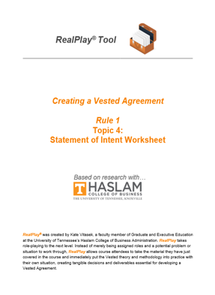
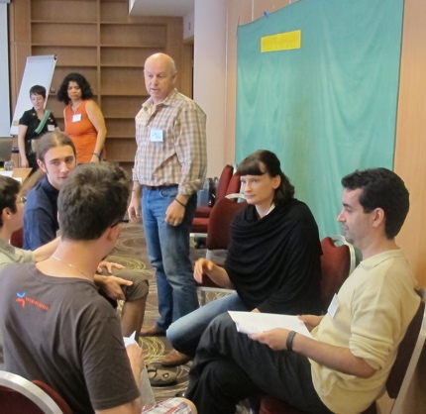
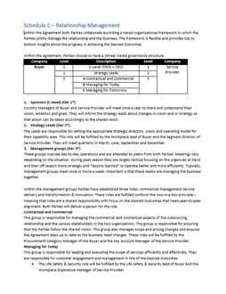
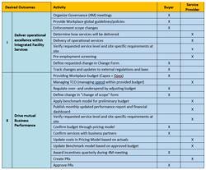
Innovative Learning by Doing RealPlay® Method
Online Course
Vested Toolkit
Workshops
Deliverables
Contract
Team members review bite size video-based topics aligned to where you are in the Vested process enabling on demand “just-in-time learning”
Includes a license to the comprehensive Vested Toolkit®
Practical resources and guides support you in ”doing” – helping you turn Vested theory into practice
Playbook provides the overall direction for each Vested Rule
Individual Toolkits are used for completing Deliverables
The joint buyer-supplier Deal Architect Team comes together in a series of workshops to collaboratively make decisions using the Playbook and Toolkits
Team members complete Deliverables as they work their way through the course/workshops one Rule at a time
Core Team Leads ensure all Deliverables are complete
Deliverables and decisions become the foundation of your agreement
Use the easy to follow Contract Template and Deliverables checklist to ensure you are thinking through all aspects of your Vested Agreement
Build your contract as you go!
Workshop photo source: https://commons.wikimedia.org/User 80686

Slide 25
Certified Deal Architect (CDA)
Understanding
Implementation
Mastery
Foundation
Certificate
Practitioner
Certificate
CERTIFIED DEAL
ARCHITECT
CDA COACH
FACULTY

Slide 26
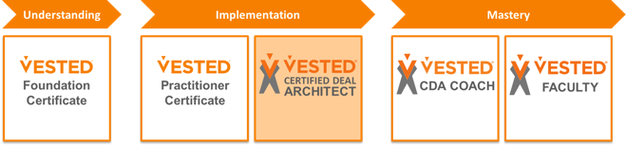
Certified Deal Architect
Individuals wanting to earn their Certified Deal Architect Certificate must complete all of the Vested courses and lead their organizations through the successful completion of a Vested Agreement including completing a UT Validation distance learning course
Awareness
Understanding
Implementation
Mastery
FREE
Creating a
Agreement
Five Rules That Will Transform
Business Relationships
CDA Coach
3-Day Executive
Education
Course
Orientation
Validation
Continuing Education
On Campus/
On Site/Virtual
Online Course
Online Course
Online Course*
Distance Learning
Distance Learning
FREE
FREE
Collaborative Contracting:
2-Day Executive
Education Course
Is
Right for Your Situation?
Getting Ready for Your
Journey
On Campus/
On Site/Virtual
Online Course
Online Course
Online Course

Slide 27
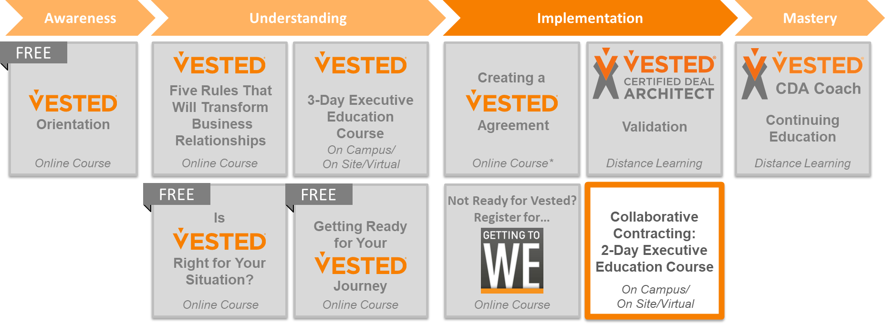
2-Day Collaborative Contracting
Implementation
Onsite: Hosted in Knoxville, Stockholm and Amsterdam or available as a private course
Virtual: The virtual option than spans five 4-hour virtual sessions
Strategic relationships require strategic contracts based a non-adversarial legal and contract framework that enables you to go beyond “Getting to Yes” to a new negotiation paradigm that allows you to “Get to We”
To reap the rewards, you will need to master 21st century collaborative contracting approaches
This advanced skills course and is ideal for those who are chartered to draft and negotiate strategic relationships on behalf of their companies. The course is a requirement for those seeking to become a Certified Deal Architect
The following page provides a course outline and learning objectives

Slide 28

What You Will Learn…
Understand why and how to negotiate the foundation of the relationship prior to negotiating any deal points
Learn and apply sound skills and techniques to help you encourage and document collaborative efforts between two non-competitive organizations (e.g., a buyer and supplier)
Get hands on experience reviewing and drafting controversial contractual clauses in using your new skills
Learn how to create “negotiating rules” with your business partner to make actual negotiations exponentially easier
Cost: $2,250* / $1,125 If Repeating
This course can also be offered as a private course and delivered on site or in a virtual classroom for your organization
Register here
*Knoxville, Tennessee option Includes Meals And Lodging
Group Pricing = $1,800 for a group of 3-4 / $1,700 for a group of 5 or more

Slide 29
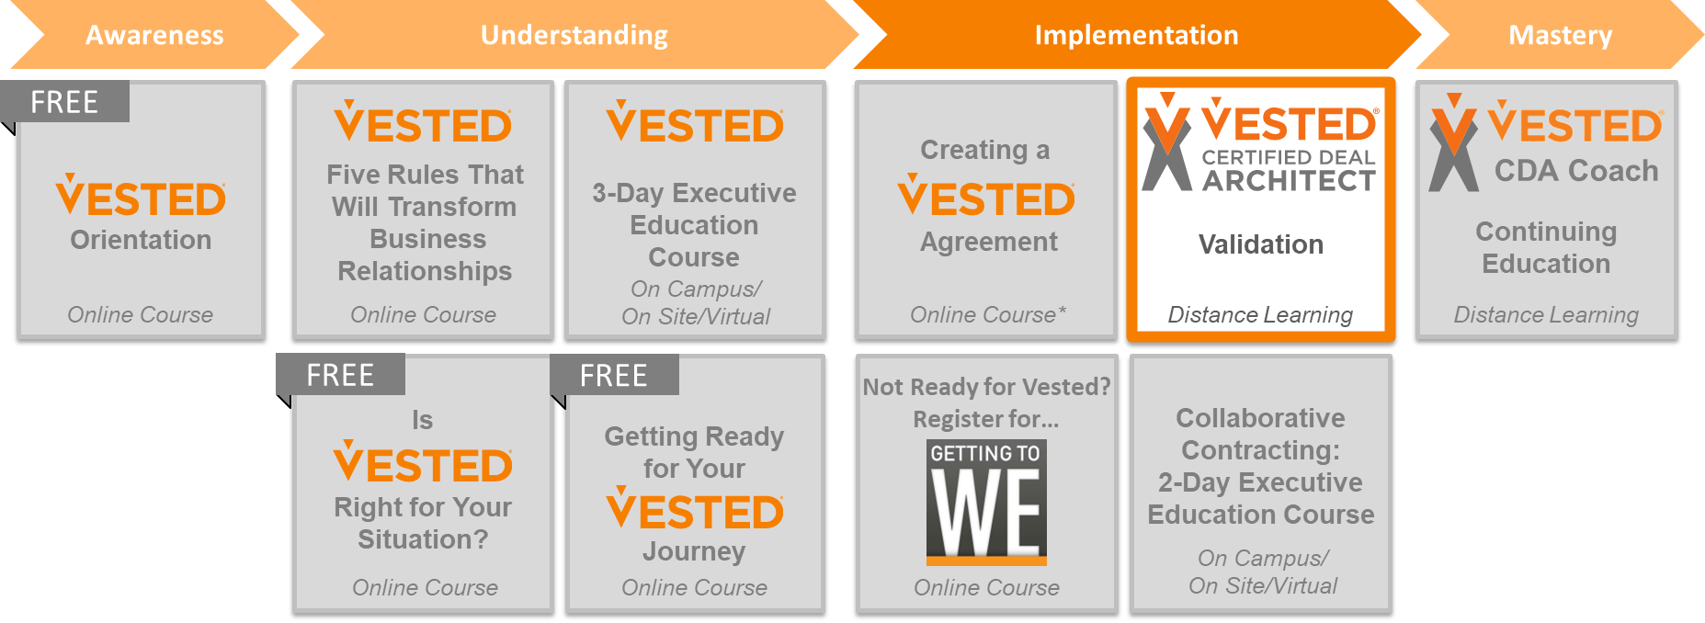
Certified Deal Architect Validation
Implementation
The UT Validation course is the capstone experience for individuals pursuing their Certified Deal Architect
This course is a one-on-one distance learning course where CDA Candidates are paired with a UT Faculty mentor
The faculty member will provide a comprehensive review of how well the CDA Candidate applied the Vested Five Rules/10 Contractual Elements in their contract.
The UT Validation course is undertaken after the individual(s) pursuing their CDA have completed their Vested Agreement
The following page provides a course outline and learning objectives
Registering for the UT Validation course is a requirement for anyone wanting to become a Certified Deal Architect

Slide 30
Certified Deal Architect Eligibility
Participants must take all of the Vested courses
Participants must also demonstrate their competency of Vested methodology by submitting a project that shows they can effectively apply their skills to create a Vested agreement
Validation typically occurs just prior to signing your agreement
Upon validation and review by a faculty member participants will receive Executive Education credit for the University of Tennessee Certified Deal Architect Program¹
Cost: $8,500*
*Team members working on the same project will be validated as a team. The first person is $8,500 and additional team members are $500 each. Must participate as a Core Team member and physically play an active effort in architecting the agreement / complete all deliverables.
^{1.} Faculty Review Performed Remotely via Conference Calls

Slide 31

What Happens When You Are Done?
Participants Graduate!
All participants will receive Executive Education credit for the University of Tennessee Certified Deal Architect Program
UT is an IAOP Academic Alliance Partner, and this class has been accepted for the Certified Outsourcing Professional Bridge Program and qualifies for COP credit.
UT is also an NCMA Education Partner.
Counts towards APICS recertification

Slide 32
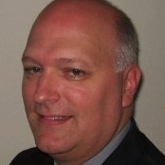
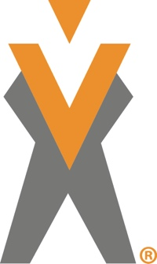
Getting Certified Is Expensive… Is It Worth It?
Darrin, working with a Vested Center of Excellence for coaching support, led Dell’s efforts to restructure their relationship with GENCO for reverse logistics
The deal took 5 months to restructure
Results after the first six months
  32% reduction in Manufacturing cost per box
  57% reduction in scrap
  Record high quality levels
  3x improvement in supplier margin
  Dell won IACCM’s award for innovation in contracting
Darrin Browder
Strategist and Supplier Relationship Manager
Dell, Inc.
The Dell case study is featured in Chapter 12 of the book Vested Outsourcing: Five Rules that will Transform Outsourcing (second edition) and in the August/Sept issues of Harvard Business Review

Slide 33

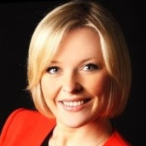

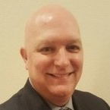


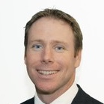


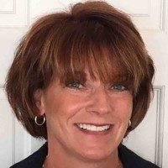

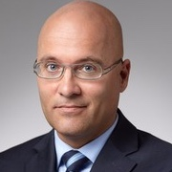

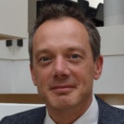




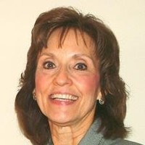

Who are CDAs?
CDAs are typically leaders in their organization who specialize in crafting strategic partnerships or deals. Meet some of our CDAs!
President, Corporate Solutions Canada
VP Business Development
Vice President Business Partnerships
Director Operations Americas
Head of Legal and Ethics
Managing Partner
Partner
Service Provider
Attorney / Consultant
Buyer
Sr Legal Counsel
Legal Counsel
Director, Business Process Outsourcing
Senior Director Business Planning
Consultant
Principal
Global Finance Manager
Site Manager
Global Category Manager
Workplace Innovation Lead
Senior Sourcing Manager
Founder
Managing Director
All Photos from LinkedIn

Slide 34
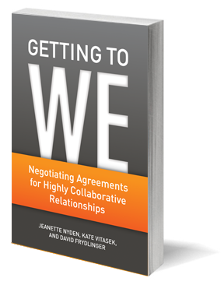
What If You Are Not Ready For Vested?
Not everyone is ready for Vested
And that is OK
We’ve create an online course that will help you lay a solid foundation for any relationship using the 5 Step Getting to We process as featured in Harvard Business Review
The online course supplements to the Getting to We book. The course comes with a toolkit that will help you and you business partner to work through each of the 5 Getting to We steps for your relationship.
You’ll end the course with the beginning of a great relationship

Slide 35
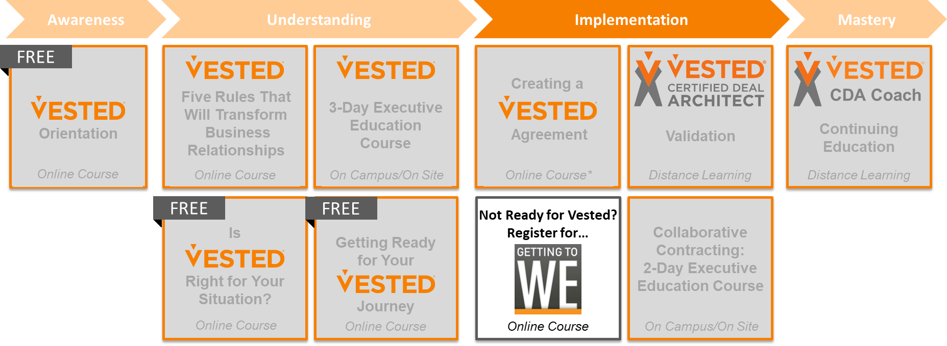
Getting To We (online)
Implementation
Not quite ready for Vested?
Then this Getting to We course is right for you because it focuses on helping you establish a “What’s-In-It-For-We” (WIIFWe) mindset and lay the groundwork for a collaborative relationship with proven relational contracting practices
The Getting to We online course provides organizations with a simple-to-follow, 5-step process and tools needed to embed relational contracting practices in any contract – big or small.
The course consists of seven Course Modules, with one Module dedicated to each of the Five Steps of Relational Contracting
Each Module includes several short (20 minutes or less) “Topics” where you will learn how to put the relational contracting theory into practice
The following page provides a course outline and learning objectives

Slide 36
What You Will Learn…
Getting to We Relational Contracting in the New Economy
Introduction | An Introduction to Getting to We
Step 1 | Lay the Foundation
Step 2 | Co-create a Shared Vision
Step 3 | Adopt Guiding Principles
Step 4 | Align Expectations and Interests
Step 5 | Stay Aligned
Conclusion | Sustaining Your Relationship
The Getting to We online course will help you:
Understand why “getting to yes” is not always good enough
Learn an easy 5-step relational contracting process for laying the foundation for highly collaborative relationships
Learn from real-world examples of how companies have applied the Getting to We program, including examples of each step in practice
Use a RealPlay® Toolkit to help you complete key deliverables for each step that will become the foundation for your relationship
Cost: Individual Seat License for $475
Corporate/group licenses available
Register here

Slide 37
CDA Coaching Program
Understanding
Implementation
Mastery
Foundation
Certificate
Practitioner
Certificate
CERTIFIED DEAL
ARCHITECT
CDA COACH
FACULTY

Slide 38
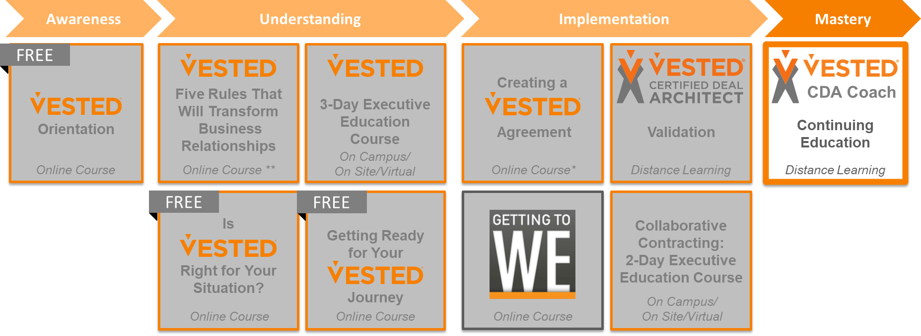
CDA Coaching Continuing Education Program
Mastery
The CDA Coaching Program offers continuing education to CDAs
GOAL:
“To create a system which continuously encourages and develops engaged and motivated CDAs who are actively growing the Vested movement globally”

Slide 39
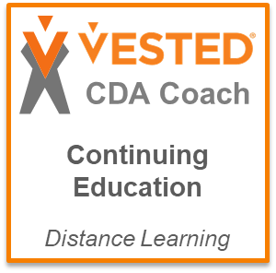
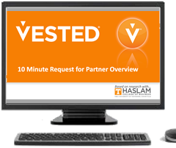




CDA Coaching Continuing Education Program
Mastery
The CDA Coaching Program is an ongoing continuing education program which brings both on-demand and in-person learning opportunities to CDA’s
The program provides CDAs with the latest case studies, best practices, tools and resources
CDAs can participate in four ways based on a CDAs personal interest
Individuals seeking to become a Certified Vested Coach need to pass a comprehensive hard skills exam and soft skills assessment
Online / On-demand Deep Dive
Learning Topics
(self paced)
Live Virtual Ask-the-Expert and Behind the Scenes Case Study
(bi-monthly)
In–Person CDA Conference
(annually)
Certified Coach Exam
(Comprehensive Hard and Soft Skills Development
with 1:1 Mentor)

Slide 40
Summary: What, When, Where, How Much and Who
What | Online Deep Dive Learning Topics | Live Virtual Ask-the-Expert and Behind the Scenes Case Study | In–Person CDA Conference | Certified Coach Exam (Comprehensive Hard and Soft Skills Development)
When | On Demand 24x7x365 | Bi-Monthly | Annual | Access to exam upon Enrollment
Where | MY ACCOUNT on www.vestedway.com Learning Management System |  | University of Tennessee (Knoxville) | Live Distance Learning with 1:1 Certified Coach Mentor
How Much | $150 Per Year |  | Varies/Cost Recovery ($375 in 2020) | $500 1-Time Enrollment Fee
Who | All CDAs |  |  | CDAs wanting to pursue Certified Vested Coach credentials
* if CDA Coach Candidate needs physical support with delivery there would be an extra costs negotiated directly between the CDA Coach Candidate and their Mentor or Center of Excellence providing the support `

Slide 41
Cost of Courses
Awareness
Understanding
Implementation
Mastery
Vested Orientation | 5 Rules that will Transform Business Relationships | Is Vested Right For Your Situation? | Getting Ready | 3 Day Executive Education Course | Creating a Vested Agreement | 2 Day Collaborative Contracting | Certified Deal Architect Validation | CDA Coaching Program
online | online | online | online | Knoxville, TN | online | Knoxville, TN | Faculty Calls | Distance Learning
FREE | $475 No charge if registering for any of the other paid courses | FREE | FREE | $3,500 (includes meals and lodging*) $3150 for a group of 3-4 $2975 for a group of 5 or more | $3500 (includes 8 hours of support) Group and Corporate License Rates available upon request | $2250 (includes meals and lodging*) $1800 for a group of 3-4 $1700 for a group of 5 or more | $8500 (4 days to validate CDA Candidate implemented skills) If working on the same project… first person is $8500 and additional are $500 each | Annual Fees $150 per individual for Continuing Education $500 one-time time fee for Certification
* Meals and lodging are included in the course offering at the University of Tennessee in Knoxville.
Lodging is not included in the Stockholm and Amsterdam course offerings
Courses are also offered as private on-site or virtual classroom settings with a substantial savings for over 15 people

Slide 42
Cost of Each Certification
Understanding
Implementation
Mastery
Foundation
Certificate
Practitioner
Certificate
CERTIFIED DEAL
ARCHITECT
CDA COACH
FACULTY
$475
$7000
Group Rates begin with two or more people
$17,750
For one person
Group Rates begin with two or more people
A Four Person Deal Team would be $10,175 each
Annual Fees
$150 per individual for Continuing Education
$500 one-time time fee for Certification
The costs shown for each level includes the cost of the previous level
The total cost to receive the Foundation, Practitioner and Certified Deal Architect Certifications for one individual is $17,750

