Slide 1
Awareness / Understanding
CaT Assessment Overview

Slide 2
What is a Compatibility Assessment?
Compatibility and trust assessments can identify gaps in compatibility and trust in a relationship
A good way to identify gaps starts with a candid discussion
Some organizations offer “assessments” to help create a candid dialogue
    FranklinCovey offers a free Trust Quotient (TQ Assessment) which is designed for individuals
    We suggest a Compatibility and Trust Assessment® (CaT) which was designed to help organizations identify and discuss gaps

Slide 3


About the Compatibility and Trust® (CaT) Assessment
The Compatibility and Trust Assessment® (CaT) was developed by Jerry Ledlow Ph.D. and Karl Manrodt Ph.D. to measure the strength of business relationships
The assessment seeks to show buyers and suppliers where they have gaps in order to help foster and build a stronger relationship
Source: http://bulletin.arcadia.edu/wp-content/uploads/2012/10/ledlow.jpg
Karl Manrodt Ph.D.
Jerry Ledlow Ph.D.
Professor of Logistics
Georgia College
Dean, School of Community and Rural Health
The University of Texas Health Science Center at Tyler

Slide 4
The CaT Assessment Identifies Each Party’s Style
Benign Styles
Muscular Styles
Avoidance
Competitive
Empathetic
Adaptive
Vested
Credible
©2011 Jerry Ledlow Ph.D. and Karl Manrodt Ph.D.- Used with permission
3 Styles (Benign, Muscular and Credible stem from Oliver Williamson’s work on transaction cost economics.

Slide 5
Five Dimensions of Compatibility and Trust
Trust: Performance to promise and meeting commitments are the foundation of trust. Without performance, trust cannot exist.
Innovation: Strong and trusting relationships allow the parties to share risks and rewards, investing in each other’s capabilities and collaborating to achieve common goals
Communication: The open and timely sharing of all information that is relevant to a partner’s decision-making ability
Team Orientation: All parties in a relationship believe in the relationship. Efforts are made to view decisions from the partner’s perspective to mitigate opportunism and promote collaboration.
Focus: There is common purpose and direction
When the five dimensions of compatibility and trust are cultivated, relationships can prosper due to greater collaboration and better performance

Slide 6
Compatibility and Trust (CaT) Index
The CaT Index scores each dimension considering the differences in scores between the parties. The lower the score, the larger the gap in perceptions of each party.
Partners that score over 0.70 have a good foundation of compatibility and trust
©2011 Jerry Ledlow Ph.D. and Karl Manrodt Ph.D.- Used with permission

Slide 7
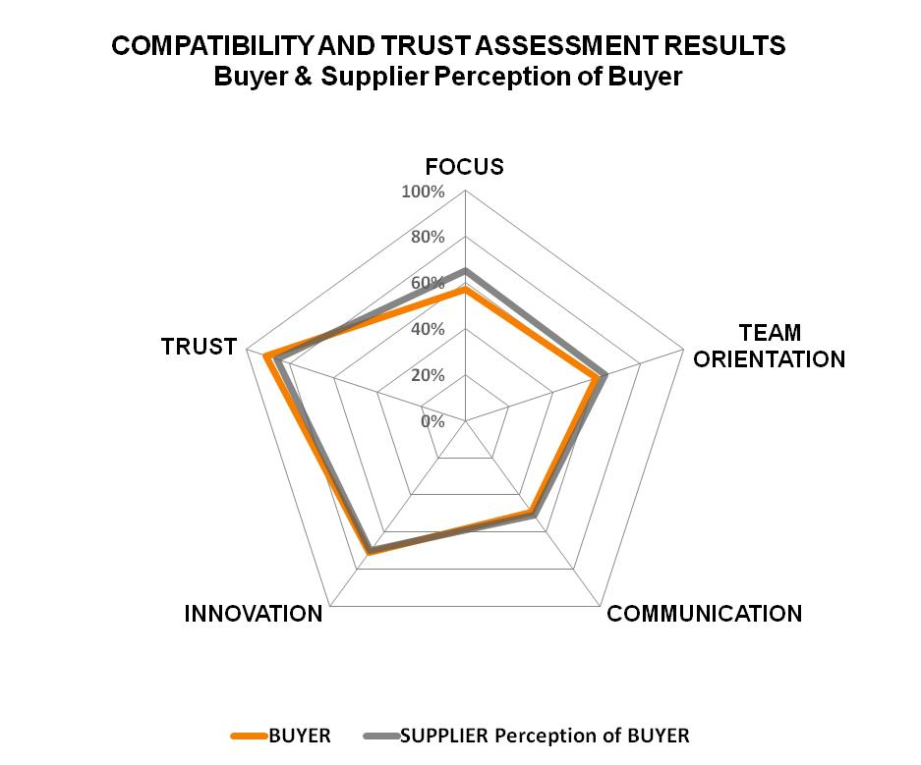
Visualizing the Scores – Small Perception Gaps
In a good relationship the views of each party show little gap in scoring across all five dimensions of compatibility and trust
Little Gap In Views
When the parties’ views align, the level of trust is improved and the potential of the relationship is enhanced
©2011 Jerry Ledlow Ph.D. and Karl Manrodt Ph.D.- Used with permission

Slide 8
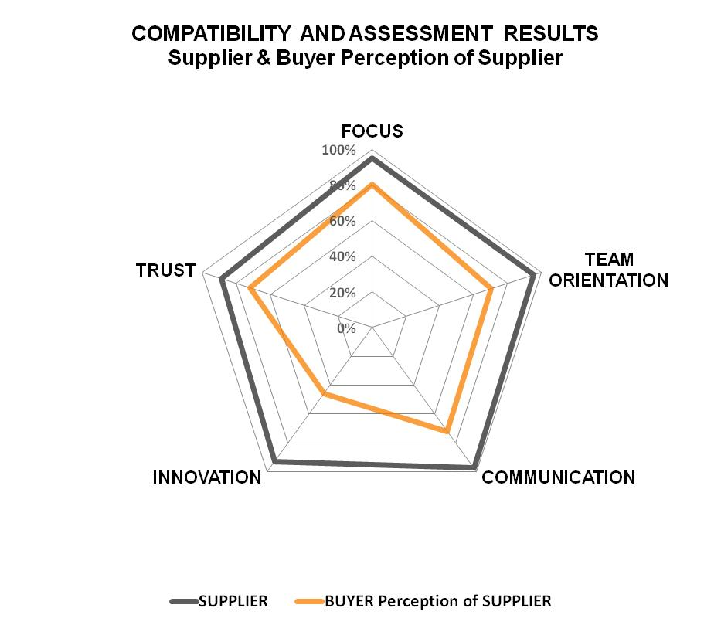
Visualizing the Scores – Large Perception Gaps
The CaT Assessment helps organizations identify perception gaps across the five dimensions of compatibility and trust; When there are gaps, the relationship needs work
Large Gaps
The survey reveals perception gaps that can erode trust and impact communication and cooperation
©2011 Jerry Ledlow Ph.D. and Karl Manrodt Ph.D.- Used with permission

Slide 9
We Map Each Party’s Style…
Value Seeking – The party with less power in the relationship tends to submit to the party with power
Value Holding – The party with more power in the relationship takes a muscular approach
Value Tipping – The parties shift between the value seeking and holding styles, the relationship lacks trust and openness
Value Fading – The relationship is dysfunctional and exhibits destructive behavior
Value Building – The parties choose to work together to build and share value equitably in the relationship. There is a good level of trust.
More Aligned
Value Building
Value Seeking
Service Provider
Relationship Dynamics
Value Tipping
Buyer
Value
Fading
Value Holding
Less Aligned
Compatibility
Alignment
Less Aligned
More Aligned
©2011 Jerry Ledlow Ph.D. and Karl Manrodt Ph.D.- Used with permission

Slide 10
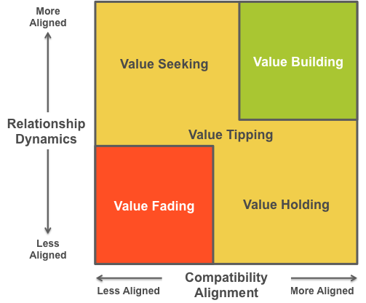
…And Look for Alignment
Misalignment: Increased transaction cost, smaller solution/agreement set of options
Alignment: Decreased transaction cost, larger solution/agreement set of options
Misalignment
Alignment
Firm A
Firm B
©2011 Jerry Ledlow Ph.D. and Karl Manrodt Ph.D.- Used with permission

Slide 11
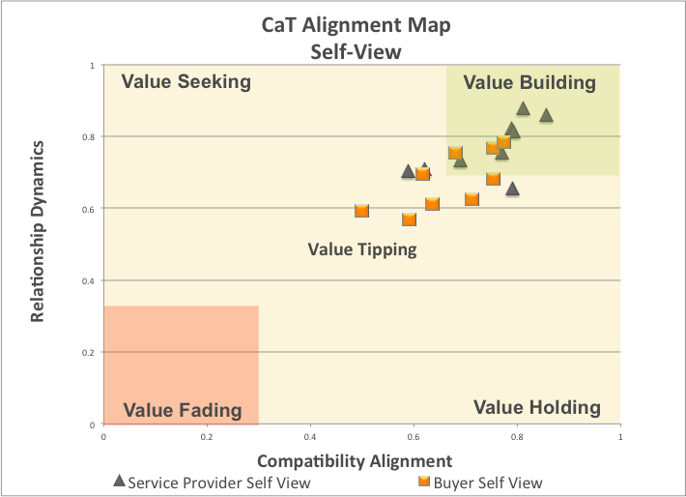
You Compatibility “DNA Footprint” – Self-View
©2011 Jerry Ledlow Ph.D. and Karl Manrodt Ph.D.- Used with permission

Slide 12
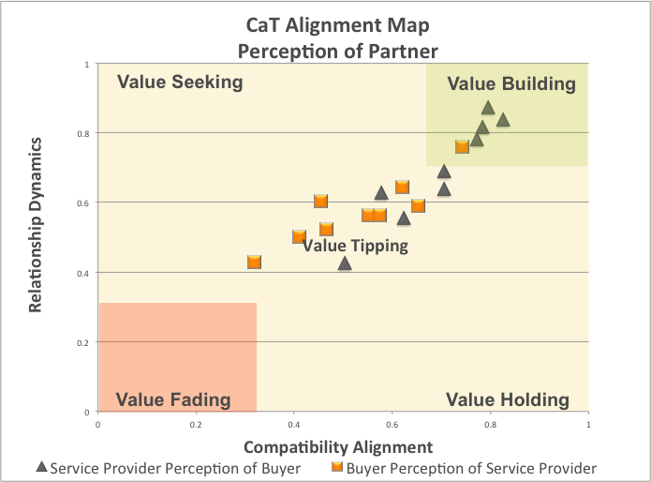
You Compatibility “DNA Footprint”– Perception of Partner
©2011 Jerry Ledlow Ph.D. and Karl Manrodt Ph.D.- Used with permission

Slide 13
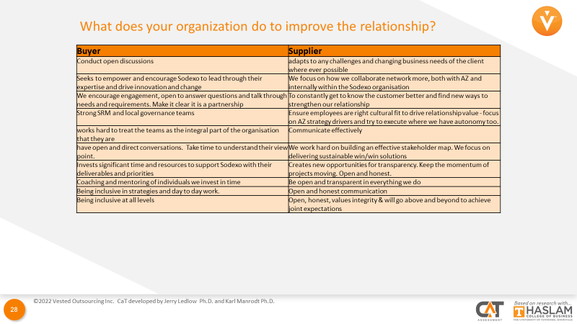
Open-Ended Questions
A CaT Assessment also includes the responses created from the open-ended questions

Slide 14
The Structure of the Assessment
The assessment is conducted using a 360 degree “two-world view” where:
  The buying company provides responses about their own organization, and their perspective of the service provider
  The service provider provides responses about their own organization, and their perspective of buying company
We ask participants to rank statements related to the relationship on a scale from “not at all” to “always”
In addition to the questions, we ask for a bit of demographic data which describes the individuals role in the buying company / service provider relationship to help us compile the results
©2011 Jerry Ledlow Ph.D. and Karl Manrodt Ph.D.- Used with permission

Slide 15
The Web-Based Trust Survey
Assessments are conducted using a confidential internet-based survey
  We create a web link to the assessment for each company
  It takes about 15-20 minutes to complete
  The link to the survey is typically kept open for 2 weeks
  Individual responses are kept confidential
Buyer-service provider teams receive a unique link that allows us to pair their data and create a 360 degree view of the relationship
©2011 Jerry Ledlow Ph.D. and Karl Manrodt Ph.D.- Used with permission

Slide 16
More Is Better
We recommend broad participation by both companies, including individuals with varying responsibilities at various levels (leadership, management, operations)
  Multi-level responses will make for better results
  The assessment format allows for a reasonably large number of people to take the survey
The more wide-ranging the responses the better we are able to capture the rhythm of the relationship between the parties
We typically see between 7 and 50 responses from both buyers and service providers

Slide 17
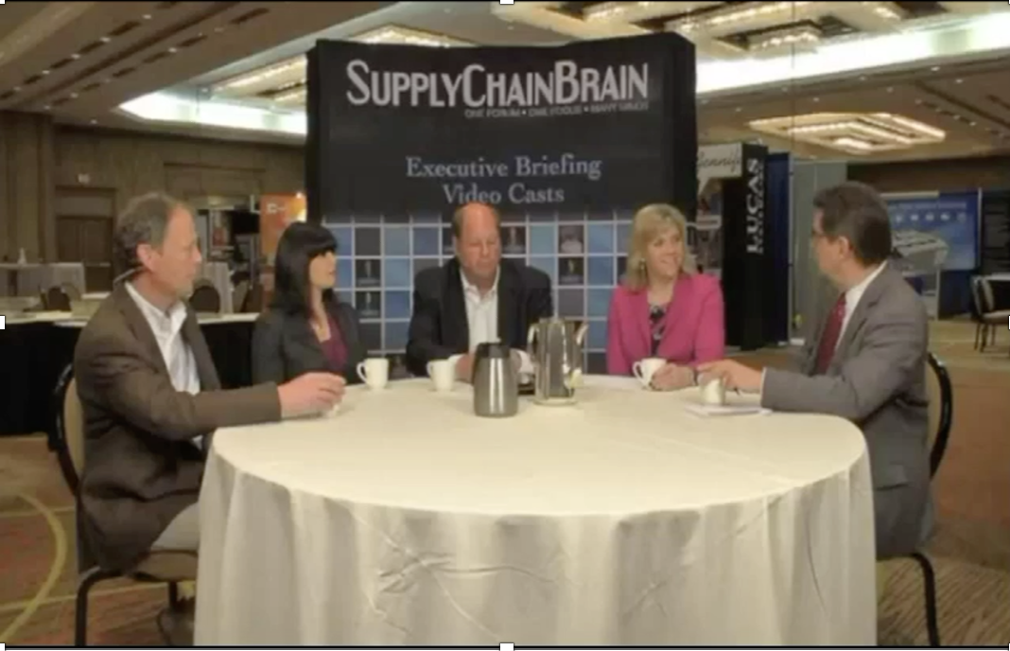
Using the Results to Focus Improvement
The Compatibility and Trust Assessment is ideally used in conjunction with a workshop where the parties engage in an open dialog on how they can improve their relationship health
  Addressing gaps in how each party views the other
  Addressing low scores across the 5 dimensions of compatibility and trust
  Ensuring the relationship is mature enough to progress to a Vested agreement
Mondelez International and
three of their suppliers discussing the CaT

Slide 18

Contact Us to Learn More or Get Started
Want to learn more about the CaT Assessment?
Email Kate Vitasek, lead faculty and researcher at kvitasek@utk.edu
Kate Vitasek
Vested Lead Faculty/Researcher
University of Tennessee

