Slide 1

Vested certified…
and what’s next?
Notes:
Maurice

Slide 2
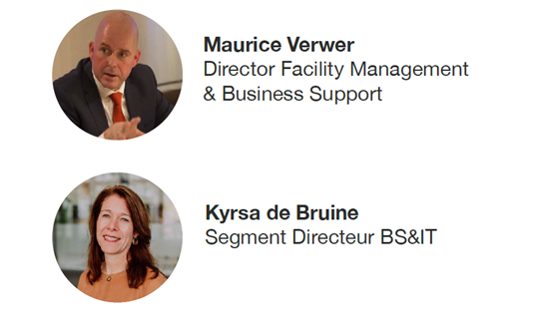

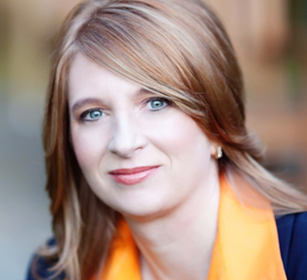

Agenda
1
Awareness
Maurice is committed to fully contribute to the strategic goals of an organisation
2
Understanding
Kyrsa is a game changer who truly builds relationships and unleashes power to create value
3
Creating
4
Kate Vitasek
Architect of the Vested Model
Kate is the World’s Authority on How to create highly collaborative relationships that drive innovation
Living
Notes:
Maurice:
Maurice will talk about the need to change and awareness
Kate will explain about the fundamentals of Vested
Kyrsa and Maurice will talk about the journey from the initial contract to the Vested contract
And we will give you an insight on living the Vested Way

Slide 3

Why...?
Notes:
MAURICE

Slide 4
Awareness
1
Notes:
MAURICE

Slide 5
Outsourcing FM 2014
Solution
Objectives
Integrated Services Provider
1. Process optimization & professionalization
2. Cost optimization and improved flexibility
3. Future career FM employees
Notes:
Maurice: scope and objectives for outsourcing

Slide 6
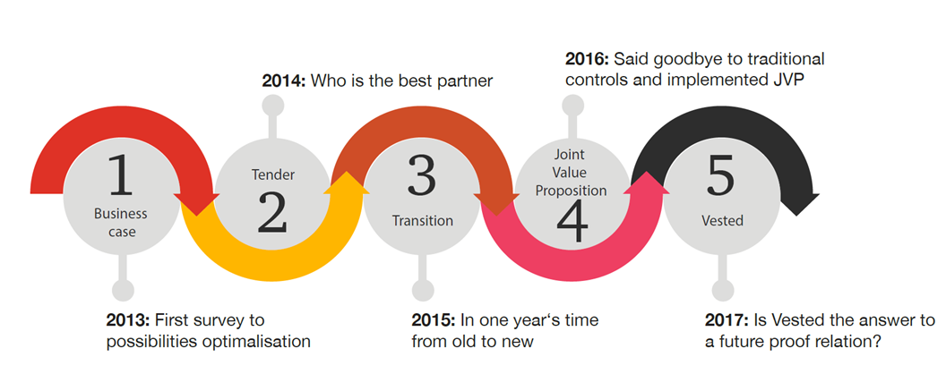
Journey so far
Notes:
MAURICE (changed Process to Journey, are you ok Maurice?)

Slide 7

Starting point
What we said
What we did
Mutual trust
Cultural fit
Shared vision
Service transformation
Hidden agendas
No financial transparency
Unaware of each others ‘pain’
Focus on SLA’s instead of guest journey
Gap between contract and ambition
Notes:
MAURICE

Slide 8
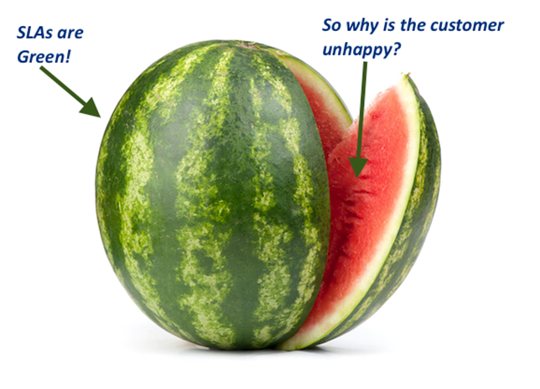
Watermelon effect
Notes:
MAURICE

Slide 9
Understanding
2
Notes:
KATE

Slide 10
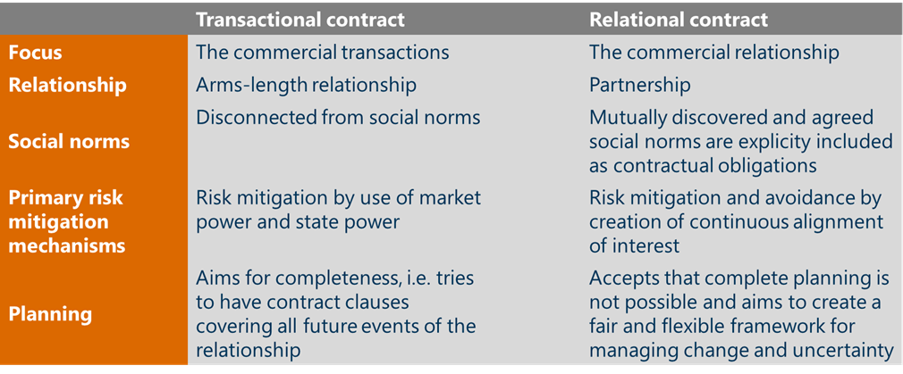
Sourcing Business Model Innovation
Essential differences to support long term strategy.
Source: University of Tennessee/Vested
Notes:
Kater instead of KYRSA )to 2)

Slide 11
Sourcing Business Model
The chosen Sourcing Business Model determines the degree of exchanging ideas and innovations between customer and supplier.
SOURCING CONTINUUM
TRANSACTIONAL
RELATIONAL
INVESTMENT
Basic Provider Model
Approved Provider Model
Prefered Provider Model
Performance Based / Managed Services Model
Vested Business Model
Shared Services Model
Equily Partnerships
Market Driven Core Improvements
Productivity Driven Improvements
Innovation
Source: University of Tennessee/Vested
Notes:
Kate ipv KYRSA (to 2)

Slide 12
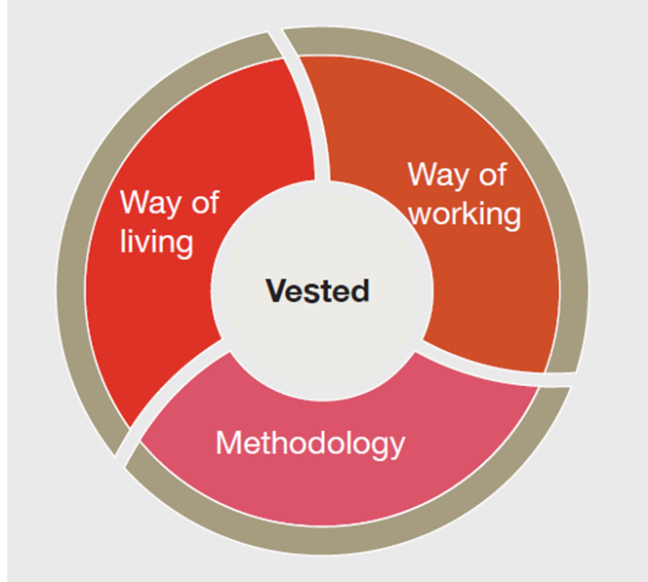
What is Vested
A business model, methodology, mentality
Extreme cooperation-oriented business relationship
Real win-win economics
Equally committed to each others succes
Shared values & Goals

Slide 13

Why Vested works

Slide 14
Five key elements of Vested
3
Clearly defined and measurable desired outcomes
2
4
Focus on the what not the how
Pricing model with incentives that optimizes the business
1
What’s in it for WE?!
5
Outcome based vs. transaction based business model
Insight vs. oversight governance structure
Notes:
KATE

Slide 15
A Vested Contract Structure
Embedded in the MSA
Master Services Agreement
Recitals
Definitions
Incorporation of Schedules
Term/Termination
Limitations of Liability
Indemnification
Representations
Warranties
Governing Law and Jurisdiction
Confidentiality/NDA
Rule 1
Rule 2
Rule 3
Rule 4
Rule 5
Outcome-Based Business Model
Focus On The
What, Not The How
Clearly Defined And Measurable Outcomes
Pricing Model With Incentives That Optimize The Business
Insight Vs. Oversight Governance Structure
Element 1
Element 3
Element 4
Element 6
Element 7
Element 10
Sourcing Business Model
Scope and Workload Allocation
Outcomes, Objectives and Measures
Pricing Model
Relationship Management
Special Concerns and External Requirements
.
.
Element 2
Element 5
Element 8
Joint Vision & Guiding Principles
Performance Work
Statement
Measurement
Processes
Transformation Management
Element 9
Joint Ownership
Exit Management
Service Provider Owned
Source: University of Tennessee/Vested
Notes:
Kate:
Each of the “Fives Rules” is broken down into their contractual “Elements”
Each Element represents a key business aspect of the relationship. For example Rule 5 includes four Elements about how the parties will govern the relationship.
Most often, organizations represent each Element as a contractual “Schedule” which provides flexibility

Slide 16
Creating
3

Slide 17
Vision & Desired Outcomes
Vision
PwC will be the pre-eminent professionals services Network Guided by our Purpose:
to build trust in society and solve important problems.
Notes:
MAURICE

Slide 18
Vision & Desired Outcomes
Vision: PwC will be the pre-eminent professionals services Network Guided by our Purpose:
to build trust in society and solve important problems.
Is supported through our Shared Vision
We partner to provide world class services and business performance to offer a work environment for both employees and guests that continuously delivers memorable experiences, aiming to beat expectations in every detail. Doing so will strengthen our brands, and contribute positively to attracting, satisfying and retaining employees. Creating the best place to be!
Notes:
MAURICE

Slide 19
Vision & Desired Outcomes
Vision: PwC will be the pre-eminent professionals services Network Guided by our Purpose:
to build trust in society and solve important problems.
Is supported through our Shared Vision
We partner to provide world class services and business performance to offer a work environment for both employees and guests that continuously delivers memorable experiences, aiming to beat expectations in every detail. Doing so will strengthen our brands, and contribute positively to attracting, satisfying and retaining employees. Creating the best place to be!
Reflected in our Desired Outcomes
First-class Integrated Facility Services
Best Facility Management (FM) company for PwC
Attract, satisfy and retain business and FM talent
Industry leader in Corporate Responsibility
Innovative and transparent financial reporting
Notes:
MAURICE

Slide 20
Desired Outcome & Statement of Objectives
1
Desired Outcome
First-class integrated facility services
Best FM company for PwC
Attract, satisfy and retain business and FM talent
Industry leader in Corporate Responsibility
Innovative and transparent financial reporting
Notes:
MAURICE`: desired outcomes = what we want
Statement of objectives = how we achieve them

Slide 21
Desired Outcome & Statement of Objectives
1
Desired Outcome
First-class integrated facility services
Best FM company for PwC
Attract, satisfy and retain business and FM talent
Industry leader in Corporate Responsibility
Innovative and transparent financial reporting
2
Statement of Objectives
High user satisfaction
Proactive communication
Work-life balance
Zero waste
Optimal price-quality
Brand protection
Innovation
Vitality
Inclusion
Budgetary framework
Quality
High satisfaction among decision makers
Inspiring working environment
Fully circular
Profitability and payment terms
Notes:
MAURICE`: desired outcomes = what we want
Statement of objectives = how we achieve them

Slide 22
Desired Outcome & Statement of Objectives
1
Desired Outcome
First-class integrated facility services
Best FM company for PwC
Attract, satisfy and retain business and FM talent
Industry leader in Corporate Responsibility
Innovative and transparent financial reporting
2
Statement of Objectives
High user satisfaction
Proactive communication
Work-life balance
Zero waste
Optimal price-quality
Brand protection
Innovation
Vitality
Inclusion
Budgetary framework
Quality
High satisfaction among decision makers
Inspiring working environment
Fully circular
Profitability and payment terms
Notes:
MAURICE`: we use innovation to drive the achievement of our statement of objectives, we value any innovation, as long as it contributes to one or more of the desired outcomes

Slide 23
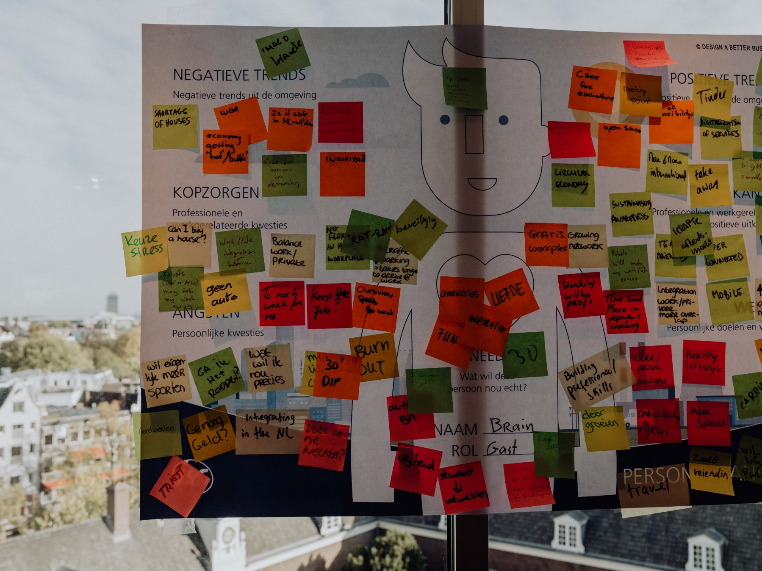
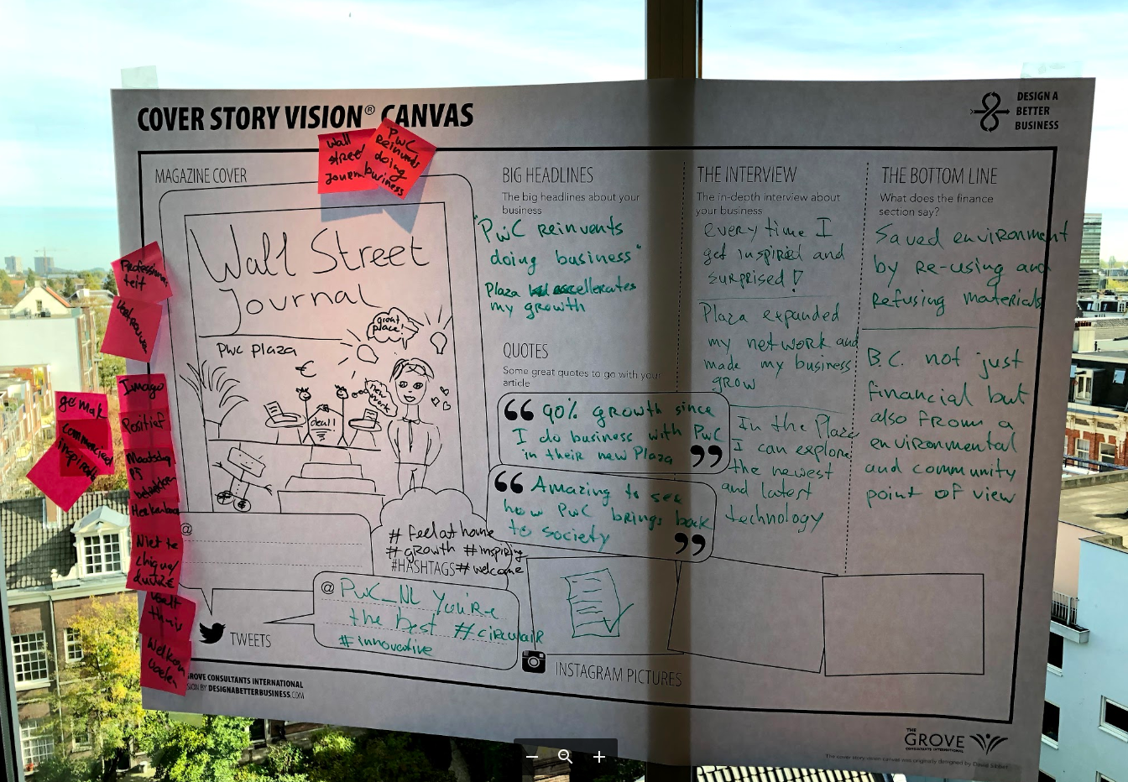

Innovation – Design Thinking
Workshop Plaza Amsterdam
Notes:
MAURICE
Design thinking workshop for Plaza

Slide 24
Desired Outcome & Statement of Objectives
1
Desired Outcome
First-class integrated facility services
Best FM company for PwC
Attract, satisfy and retain business and FM talent
Industry leader in Corporate Responsibility
Innovative and transparent financial reporting
2
Statement of Objectives
High user satisfaction
Proactive communication
Work-life balance
Zero waste
Optimal price-quality
Brand protection
Innovation
Vitality
Inclusion
Budgetary framework
Quality
High satisfaction among decision makers
Inspiring working environment
Fully circular
Profitability and payment terms
Notes:
MAURICE`: PwC aims to be fully circular in 2030: to achieve that, ISS needs to partner with us to think outside the box about her the approach on the current services. Our Vested approach incentivizes ISS to come up with new solutions and PwC partner with ISS, truly based on what’s in it for we. We are happy to share the created value for PwC so ISS is motivated to go even further.

Slide 25







Fully Circular - Catering
Notes:
MAURICE
An example in our catering services to become fully circular in minimizing foodwaste:
Awareness: Minimize waste through the startup app Wastewatchers: this helps the catering team to focus on reducing foodwaste
Cooking: Via Instock we use unsold products from supermarkets in our daily receipts
Kromkommer: we serve soups from wonky vegetables and fruits
Coffee: part of the coffe we serve in our outlets comes from Gosling Coffe: bought as much as possible directly from farmers for a fair price, at the same time supporting Farmers in education and collaboration.
And if we can’t sell all our products in the restaurant: we sell these items via the reqzone app at a good rebate

Slide 26
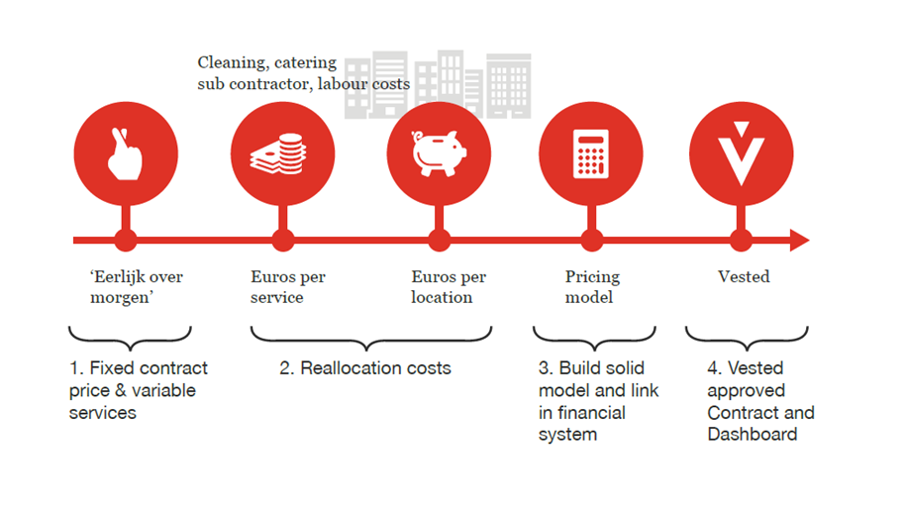
Contract flip
Notes:
KYRSA
We needed a pricing model to support our shared vision and desired outcomes. So we made a flip from the current contract to the vested apprach

Slide 27
Financial transparent pricing model supporting the desired outcomes, based on ‘cost are the cost are the cost’
Service delivery
Transformation
Base Services
Other Services
Governance Structure
Transformation Projects
Fixed monthly invoice based on cost are the cost
Variable cost pass through; cost are the cost
Fixed cost on account management: cost are the cost
Fixed budget for overhead and profit, based on yearly budget
partly performance based
Project based with transformation incentive.
Driving cost control through operational excellence
Driving TCO reduction and expanding the pie through innovation
Notes:
KYRSA

Slide 28

Saving initiative
Notes:
Kyrsa: explain saving initiative

Slide 29
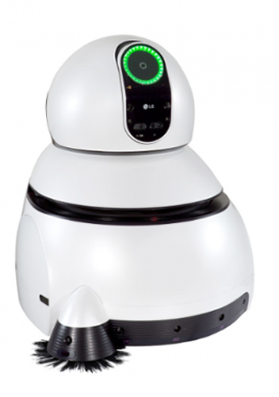
Saving initiative
Notes:
Kyrsa: explain saving initiative

Slide 30
Effect of saving
Current tariff
Profit
Overhead
Cost price
Notes:
Kyrsa: start from price: saving leads to less margin and overhead for ISS while cost hasn’t changed
When will ISS be more likely to actually make a saving

Slide 31
Effect of saving to support short term win
Current tariff
Traditional contract
Profit
Saving
Saving for PwC is not in ISS interest
Profit
Overhead
Saving
Overhead
Cost price
Saving
Cost price
Notes:
Kyrsa: start from price: saving leads to less margin and overhead for ISS while cost hasn’t changed
When will ISS be more likely to actually make a saving

Slide 32
Effect of saving to support long term strategic outcome
Vested
contract
Current tariff
Traditional contract
Profit
Profit
Saving
Saving for PwC is not in ISS interest
Saving for PwC creates an incentive for ISS
Profit
Overhead
Overhead
Saving
Overhead
Saving
Cost price
Saving
Cost price
Cost price
Notes:
Kyrsa: start from price: saving leads to less margin and overhead for ISS while cost hasn’t changed
When will ISS be more likely to actually make a saving

Slide 33
Governance - ‘’two in the box’’
Managing for today -
Operations
Site managers ISS
How
Level 3
Managing for tomorrow -
Projects, Innovations & Improvements
Sr. Portfolio Manager PwC
Innovation Lead ISS
What
Level 2
Managing today -
Tactical / Strategy
Sr. Portfolio Manager PwC
Demand Manager PwC
Key Account Manager ISS
Contractual / Commercial
Demand Manager PwC
Category Manager PwC
Key Account Manager ISS
Financial
Business Controller PwC
Business Controller ISS
Strategical
Director FM & BS PwC
Demand Manager PwC
Segment Director ISS
Why
Level 1
Sponsors
Board Member PwC
CEO ISS
Notes:
KYRSA
We need a Clear structure on who is responsible for the why what and how and how address them in the governance structure, thus achieving our desired outcomes and addressing issues at the right level to interfere

Slide 34
Governance - ‘’two in the box’’
Key focus points
Managing for today -
Operations
Site managers ISS
How
Level 3
How we adress them
Managing for tomorrow -
Projects, Innovations & Improvements
Sr. Portfolio Manager PwC
Innovation Lead ISS
What
Level 2
Managing today -
Tactical / Strategy
Sr. Portfolio Manager PwC
Demand Manager PwC
Key Account Manager ISS
Contractual / Commercial
Demand Manager PwC
Category Manager PwC
Key Account Manager ISS
Financial
Business Controller PwC
Business Controller ISS
Strategical
Director FM & BS PwC
Demand Manager PwC
Segment Director ISS
Why
Level 1
Sponsors
Board Member PwC
CEO ISS
Notes:
KYRSA
We are clear who needs te decide on what, which makes the partnership efficient

Slide 35
Living
4
Notes:
MAURICE

Slide 36
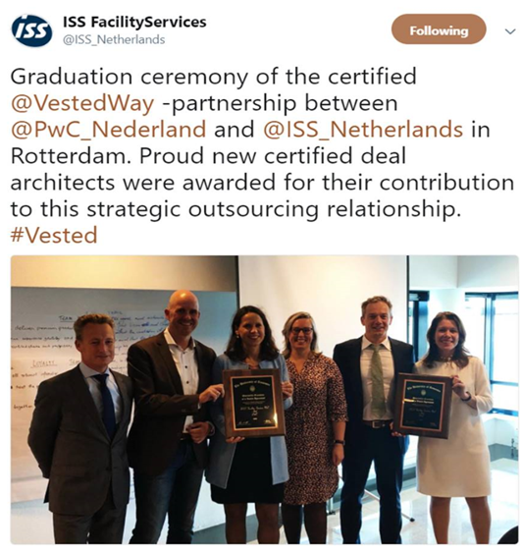
The start of a new age
Certified deal signed onJuly 1st of 2018
Notes:
MAURICE

Slide 37
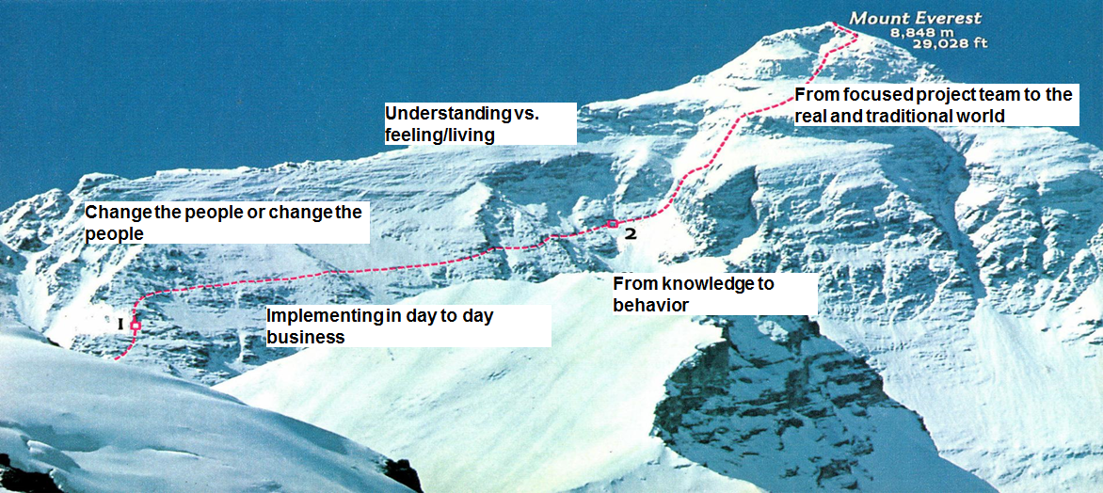
And then… the real challenge starts!
Notes:
MAURICE
Having all in place doesn’t change behavior so easily

Slide 38
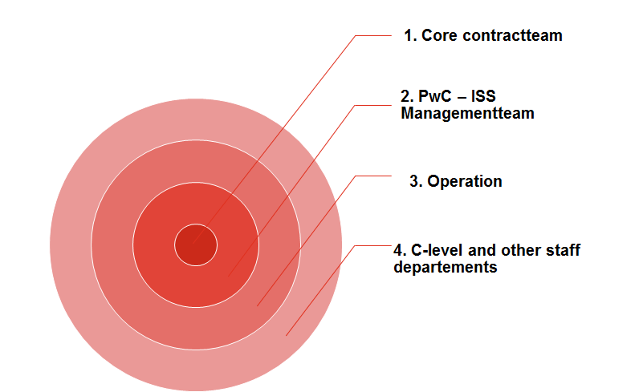
The difficulty lies not so much in developing new ideas as in escaping from old ones
  John Maynard Keynes
Notes:
MAURIC
WE need to drive change, consistently
2 corporates partnernering

Slide 39
Evidence
1
Desired Outcome
First-class integrated facility services
Best FM company for PwC
Attract, satisfy and retain business and FM talent
Industry leader in Corporate Responsibility
Innovative and transparent financial reporting
2
Evidence
No incidents
Releezme &
Mapiq
Multiple catering outlets
ResQ-zone
Real time dashboard
Customer satisfaction above target
Integrated operational services
30% healthy products in restaurants
27 staff members with a distance to labor market
Mobile phone dashboard app
All technical audits passed
One team!
Apps to order and pay coffee
15 Social Enterprises as subcontractors
Several realized savings
Activity Based Working
Waste reduction with 35%
Plaza Area
Notes:
KYRSA in the mean time we have achieved a lot

Slide 40
Evidence
1
Desired Outcome
First-class integrated facility services
Best FM company for PwC
Attract, satisfy and retain business and FM talent
Industry leader in Corporate Responsibility
Innovative and transparent financial reporting
2
Evidence
No incidents
Releezme &
Mapiq
Multiple catering outlets
ResQ-zone
Real time dashboard
Customer satisfaction above target
Integrated operational services
30% healthy products in restaurants
27 staff members with a distance to labor market
Mobile phone dashboard app
All technical audits passed
One team!
Apps to order and pay coffee
15 Social Enterprises as subcontractors
Several realized savings
Activity Based Working
Waste reduction with 35%
Plaza Area
Notes:
KYRSA we make sure that all basic objectives are met.. And more: it starts with the satisfaction of our day to day customers

Slide 41
Evidence
1
Desired Outcome
First-class integrated facility services
Best FM company for PwC
Attract, satisfy and retain business and FM talent
Industry leader in Corporate Responsibility
Innovative and transparent financial reporting
2
Evidence
No incidents
Releezme &
Mapiq
Multiple catering outlets
ResQ-zone
Real time dashboard
Customer satisfaction above target
Integrated operational services
30% healthy products in restaurants
27 staff members with a distance to labor market
Mobile phone dashboard app
All technical audits passed
One team!
Apps to order and pay coffee
15 Social Enterprises as subcontractors
Several realized savings
Activity Based Working
Waste reduction with 35%
Plaza Area
Notes:
KYRSA PwC has implemented abw in all her offices, thus we needed to change our services accordingly to support the ABW vision of PwC. The flexible framework of our vested contract supported this transition, not only in the integration of roles but also in the creation of new ones.

Slide 42
Evidence
1
Desired Outcome
First-class integrated facility services
Best FM company for PwC
Attract, satisfy and retain business and FM talent
Industry leader in Corporate Responsibility
Innovative and transparent financial reporting
2
Evidence
No incidents
Releezme &
Mapiq
Multiple catering outlets
ResQ-zone
Real time dashboard
Customer satisfaction above target
Integrated operational services
30% healthy products in restaurants
27 staff members with a distance to labor market
Mobile phone dashboard app
All technical audits passed
One team!
Apps to order and pay coffee
15 Social Enterprises as subcontractors
Several realized savings
Activity Based Working
Waste reduction with 35%
Plaza Area
Notes:
KYRSA we take our joint social responsibility very serious.. We partner both te help future fm staff aquire work experience as we try to find refugees for the PwC business, first learning the Dutch language an customs in ISS, to further grow in their ambition within the PwC business

Slide 43
Evidence
1
Desired Outcome
First-class integrated facility services
Best FM company for PwC
Attract, satisfy and retain business and FM talent
Industry leader in Corporate Responsibility
Innovative and transparent financial reporting
2
Evidence
No incidents
Releezme &
Mapiq
Multiple catering outlets
ResQ-zone
Real time dashboard
Customer satisfaction above target
Integrated operational services
30% healthy products in restaurants
27 staff members with a distance to labor market
Mobile phone dashboard app
All technical audits passed
One team!
Apps to order and pay coffee
15 Social Enterprises as subcontractors
Several realized savings
Activity Based Working
Waste reduction with 35%
Plaza Area
Notes:
KYRSA we have an online and real tim dashboard where we can follow up on our desired outcomes, in full financial transpareny

Slide 44
Evidence
1
Desired Outcome
First-class integrated facility services
Best FM company for PwC
Attract, satisfy and retain business and FM talent
Industry leader in Corporate Responsibility
Innovative and transparent financial reporting
2
Evidence
No incidents
Releezme &
Mapiq
Multiple catering outlets
ResQ-zone
Real time dashboard
Customer satisfaction above target
Integrated operational services
30% healthy products in restaurants
27 staff members with a distance to labor market
Mobile phone dashboard app
All technical audits passed
One team!
Apps to order and pay coffee
15 Social Enterprises as subcontractors
Several realized savings
Activity Based Working
Waste reduction with 35%
Plaza Area
Notes:
KYRSA we are truly one team!

Slide 45
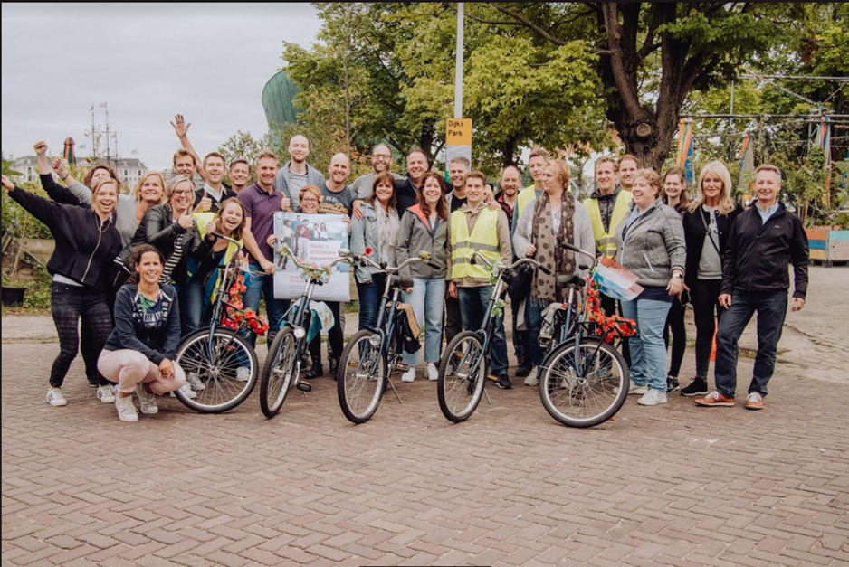
  Thank you!
  Any questions?
One Team
Notes:
KYRSA

